Slide 1
Towards Low-Energy Leakage-Resistant
Authenticated Encryption from
the Duplex Sponge Construction
Chun Guo, Olivier Pereira,
Thomas Peters, and François-Xavier Standaert
IACR FSE 2020

Slide 2
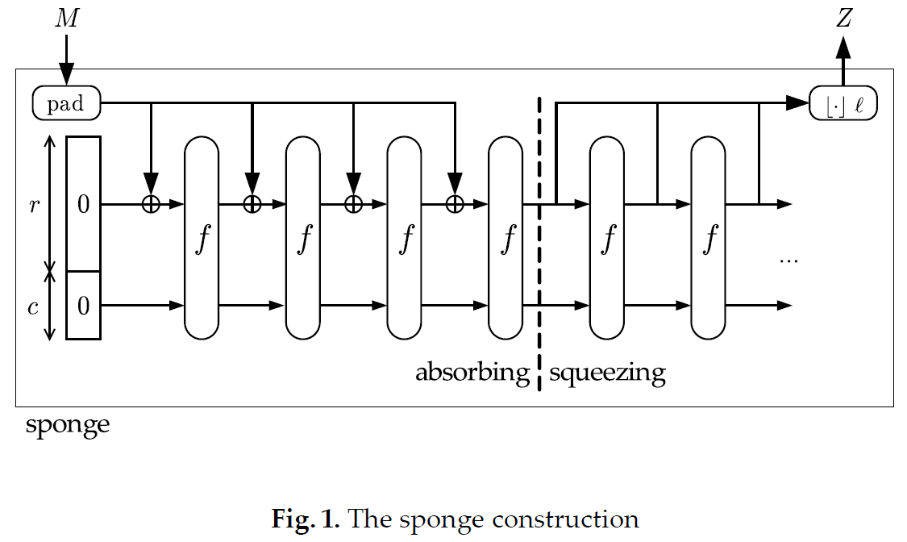
Sponge and duplex construction [BDPV07]

Slide 3
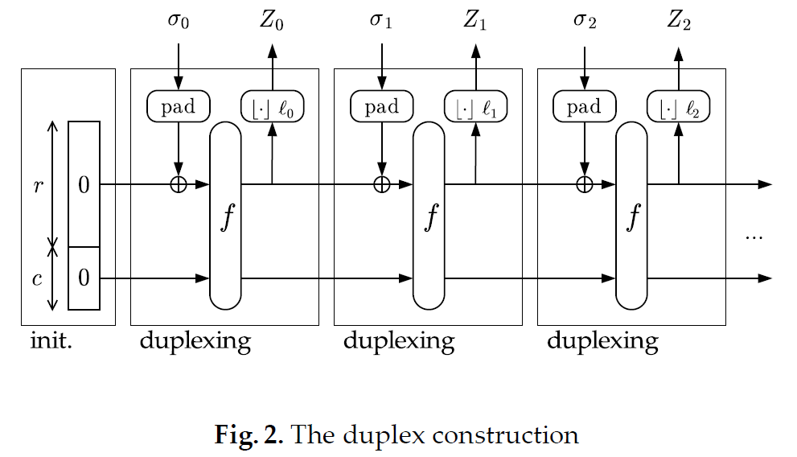
Sponge and duplex construction [BDPV11]

Slide 4
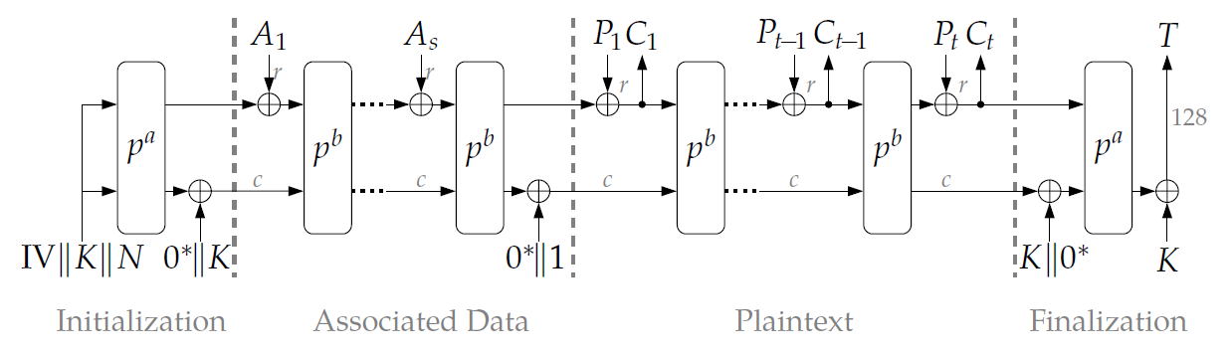
Duplex-based authenticated encryption
Ascon

Slide 5
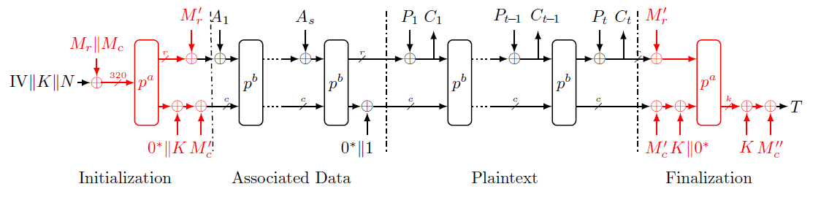
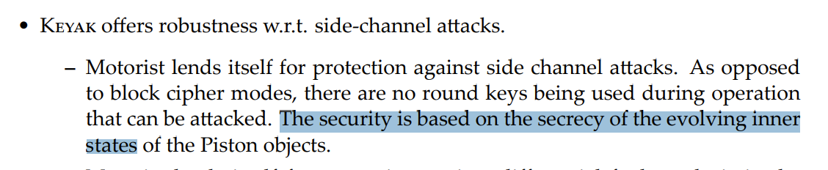
Masking duplex [AFM18]: leakage-resilience?
1.
2.

Slide 6
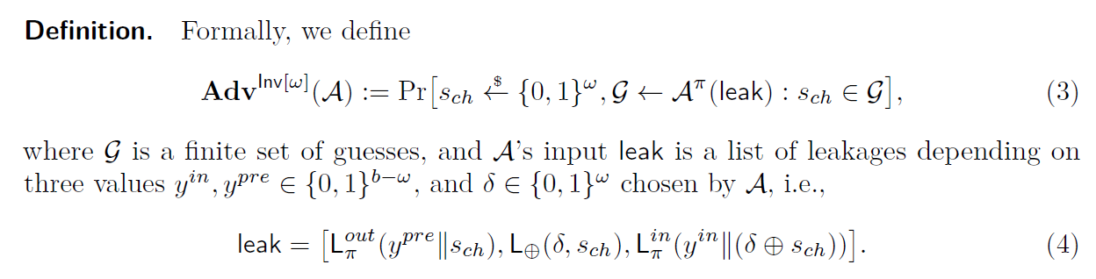
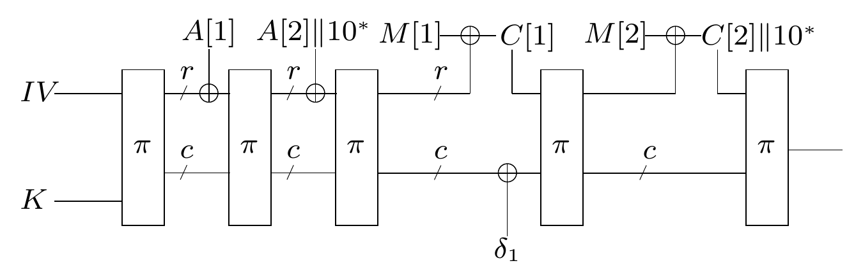
Our first result: leakage-resilience of duplex
Security model: leakage eavesdropper security [PSV15]
Limited advantage of distinguishing encrypting M0 and M1 with leakages
Unpredictable state

Slide 7
Our first result: leakage-resilience of duplex
Security model: leakage eavesdropper security [PSV15]
Limited advantage of distinguishing encrypting M0 and M1 with leakages
Limited distinguishing advantage
Unpredictable state
Random permutation

Slide 8
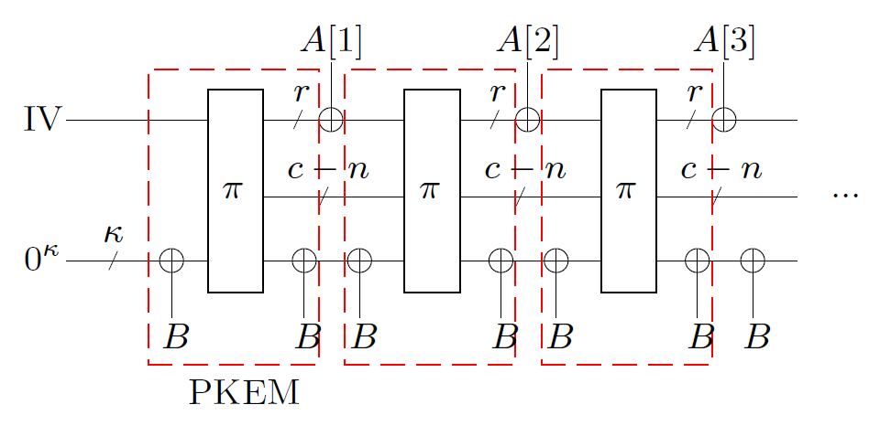
Our first result: leakage-resilience of duplex
Security model: leakage eavesdropper security [PSV15]
Limited advantage of distinguishing encrypting M0 and M1 with leakages
Limited distinguishing advantage
Unpredictable state
Random permutation

Slide 9
Comparison
Dobraunig and Mennink [DM19]: Entropy-preserving leakages
Degabriele et al. [DJS19]: Bounded-output leakages
Simple and concise theory
Unpredictable leakages is closer to practice [SPY13]
Experimentally verifiable
Complementary

Slide 10
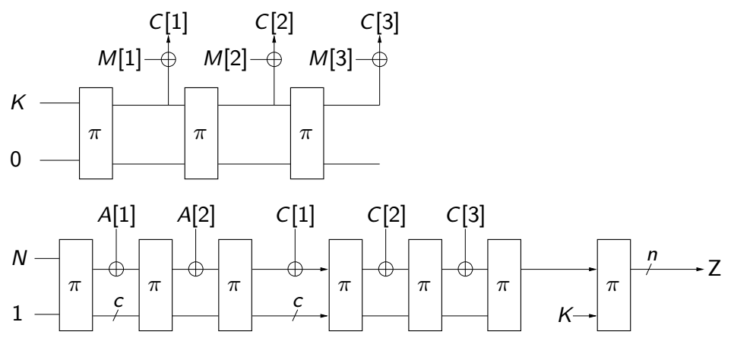
From duplex to AE
Enc-then-MAC: Duplex Stream cipher + Sponge-based MAC
  Strong integrity
  CCA security

Slide 11
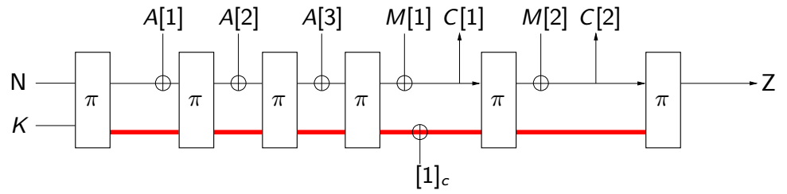
From duplex to 1-pass AE
1-pass is not good for decryption leakages [BMOS17, BPPS17]
What can be achieved at this “more efficient” side?

Slide 12
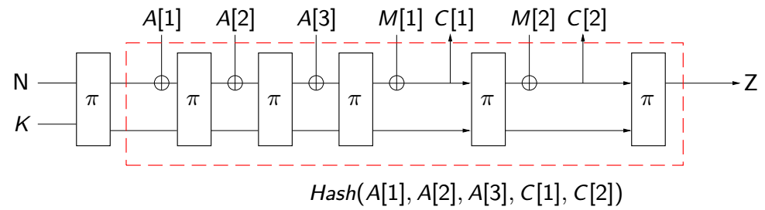
From duplex to 1-pass AE: Duplex for two roles
With secrets: a standard 1-pass duplex-based AE
With no secret: a hash (we can play with the hash digest Z)

Slide 13
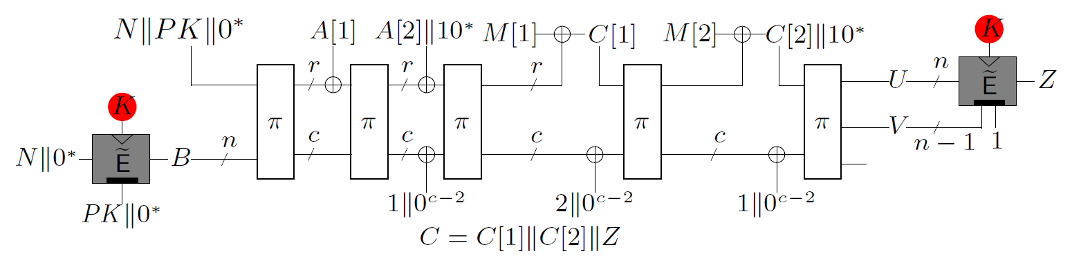
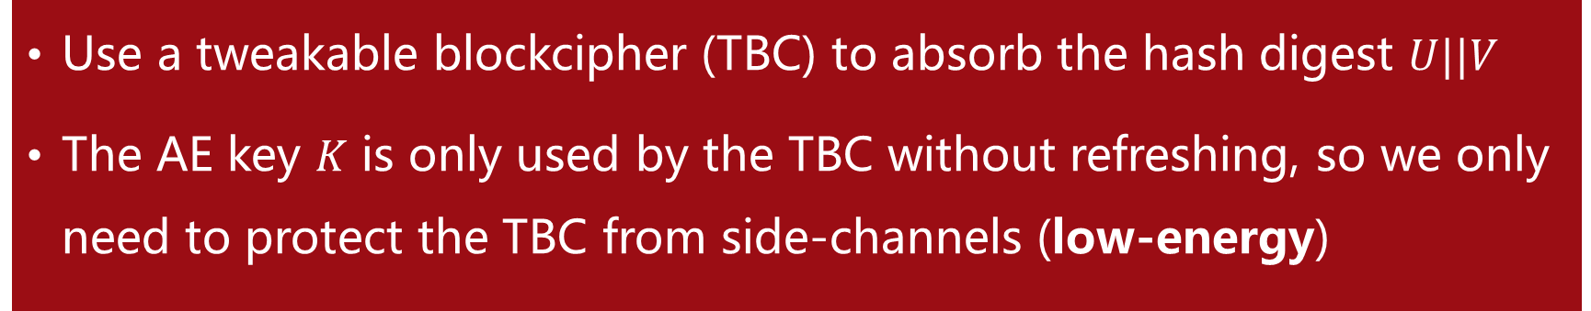
Our second result: duplex-based 1-pass AE
Use a tweakable blockcipher (TBC) to absorb the hash digest $U||V$
The AE key 𝐾 is only used by the TBC without refreshing, so we only need to protect the TBC from side-channels (low-energy)

Slide 14
Inversing the TBC (follows [BGP+20])
Dec(N,A,C||Z): meet-in-the-middle style integrity checking
2n-bit digest: beyond n/2=64-bit integrity
N,A,C
U=?U*
Z

Slide 15
Leakage security
Security against decryption leakages remains achievable: ciphertext integrity against nonce-misuse and decryption leakages (CIML2)
CCA security with encryption leakages on fresh nonces (CCAmL1)

Slide 16
Public key for better multi-user security ([BGP+20])
Setting: the mode is deployed en mass (e.g., in the TLS scenario)
Adv goal: breaking one of the 𝑢 instances rather than a specific
Public key as the tweak to avoid attack with complexity 2^|𝐾|/𝑢

Slide 17
Domain separation bits
Whether the last block of A/M is full
Where is the commence of M

Slide 18
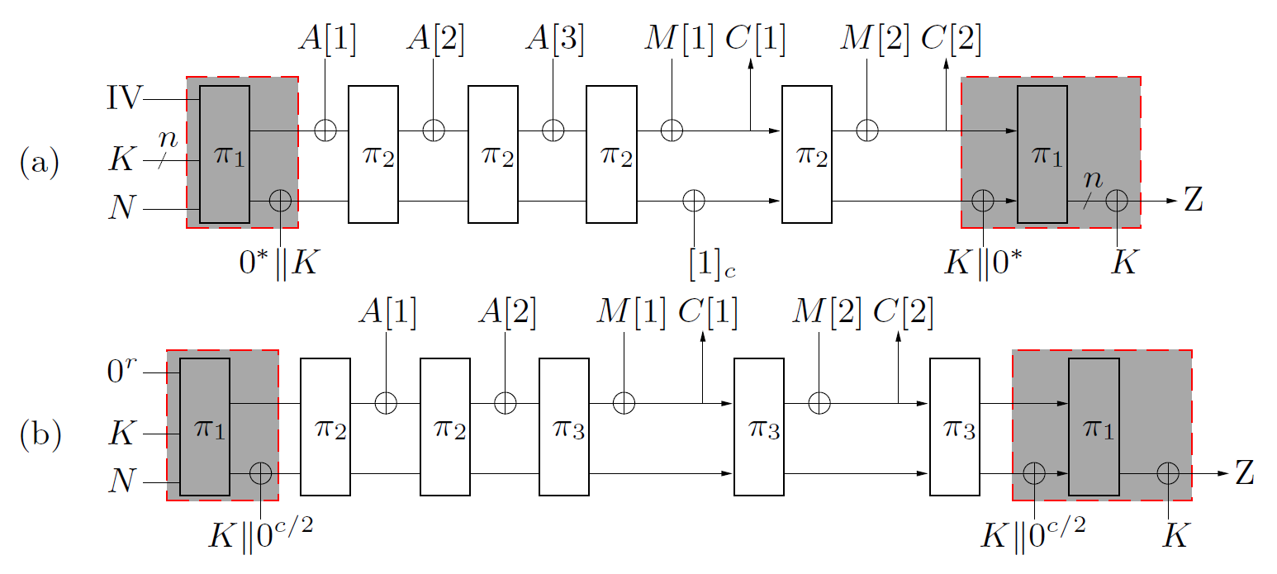
Meeting Ascon & GIBBON
Single round function
Inverse free
More mode-level side-channel security

Slide 19
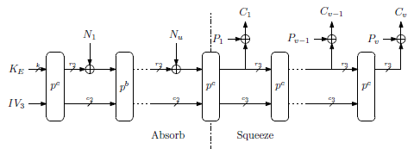
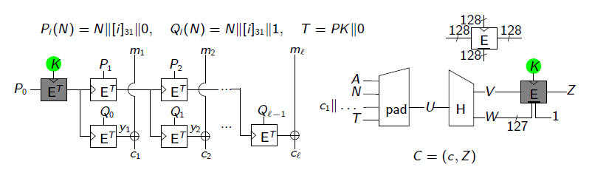
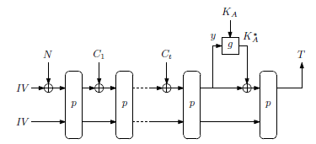
Other leakage-resilient designs
Ascon, GIBBON
TEDT, ISAP: 2 passes

Slide 20
Public key vs. Nonce randomization
RGCM in TLS 1.3: nonce randomization for difference
Random public key
  Randomness once for all
  New designs
Random nonce
  Underlying AE almost as a black-box
  More randomness or more computations

Slide 21
Summarizing

Slide 22
Leakage-resilience of Duplex
Keyed sponge and duplex have mode-level leakage resilience
Minimal leakage assumptions of unpredictability suffice
Limited distinguishing advantage
Unpredictable state
Random permutation

Slide 23
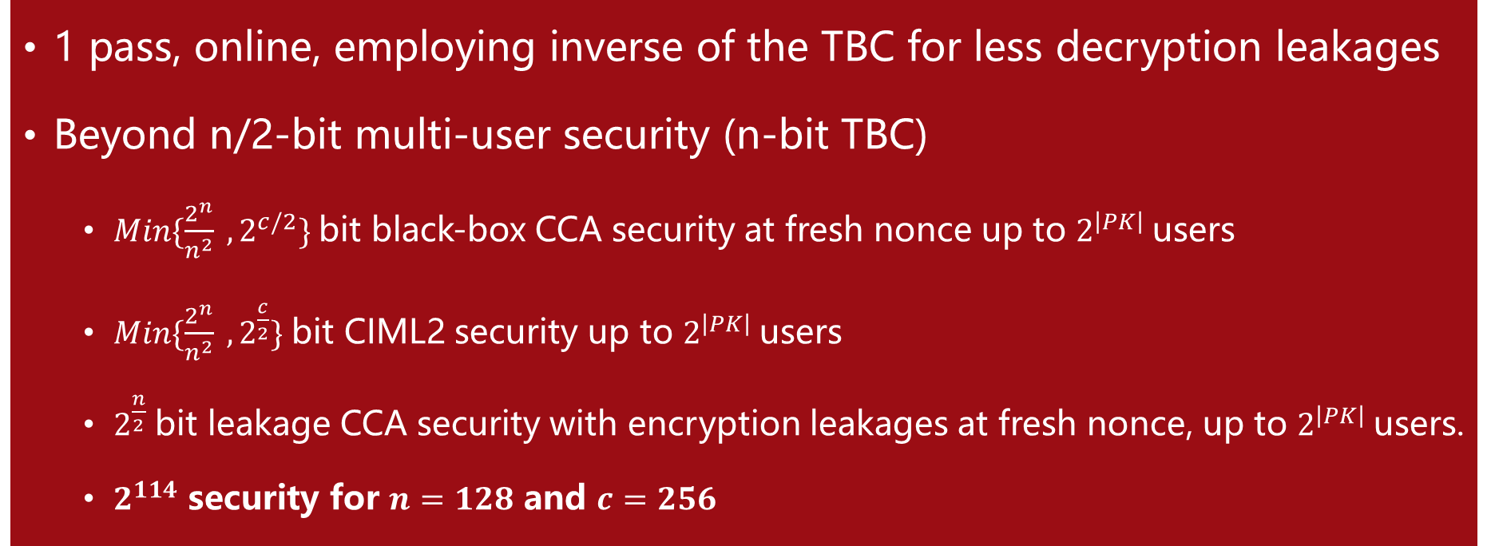
TETSponge
1 pass, online, employing inverse of the TBC for less decryption leakages
Beyond n/2-bit multi-user security (n-bit TBC)
  $Min\{\frac{2^{n}}{n^{2}} ,2^{c/2}\}$bit black-box CCA security at fresh nonce up to $2^{\left|PK\right|}$users
  $Min\{\frac{2^{n}}{n^{2}} ,2^{\frac{c}{2}}\}$bit CIML2 security up to $2^{\left|PK\right|}$users
  $2^{\frac{n}{2}}$bit leakage CCA security with encryption leakages at fresh nonce, up to $2^{\left|PK\right|}$users.
  $2^{114}$ security for $n=128$ and $c=256$

Slide 24
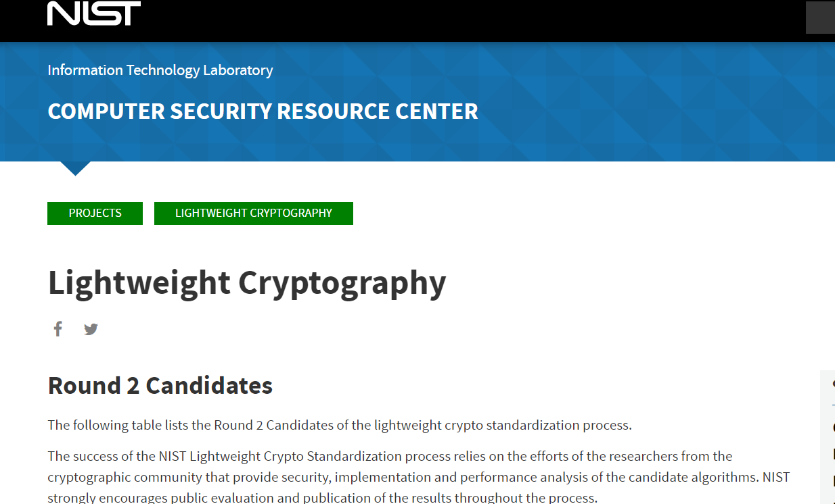
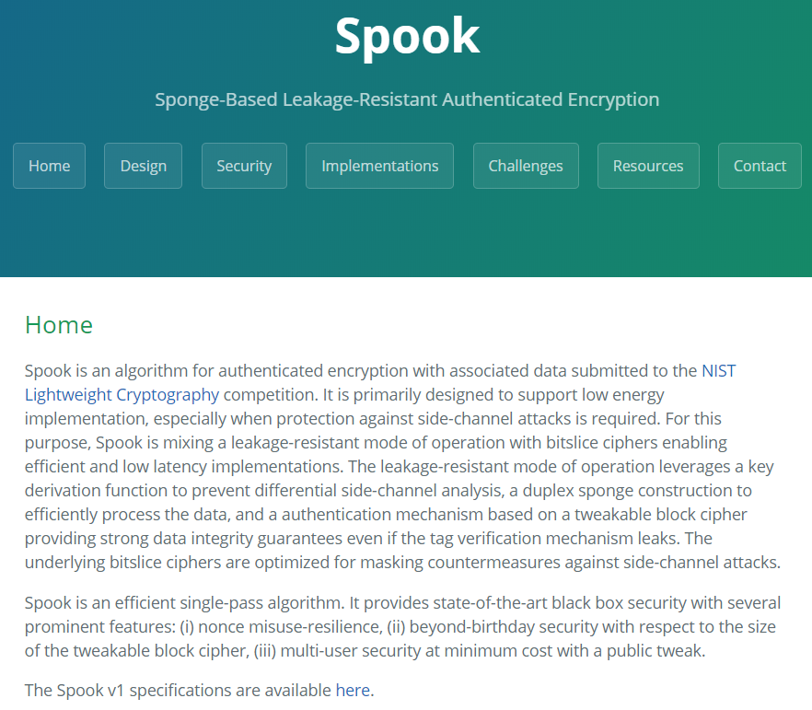
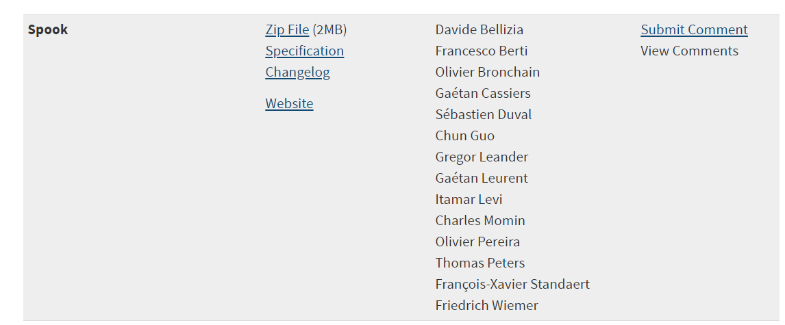
From TETSponge to Spook
  https://www.spook.dev/

Slide 25
Thank you!
Questions or comments?

Slide 26
References
[AFM18] Alexandre Adomnicai, Jacques J.A. Fournier, and Laurent Masson. Masking the Lightweight Authenticated Ciphers ACORN and Ascon in Software. Crypto eprint.
[BDPV07] Guido Bertoni, Joan Daemen, Michaël Peeters, and Gilles Van Assche. Sponge Functions.
[BDPV11] Guido Bertoni, Joan Daemen, Michaël Peeters, and Gilles Van Assche. Duplexing the sponge: single-pass authenticated encryption and other applications. SAC 2011.
[BDPVV16] Guido Bertoni, Joan Daemen, Michaël Peeters, Gilles Van Assche, and Ronny Van Keer. CAESAR submission: Keyak v2.
[BGP+19] Francesco Berti, Chun Guo, Olivier Pereira, Thomas Peters, and François-Xavier Standaert. TEDT, a leakage-resist AEAD mode for high (physical) security applications. CHES 2020.
[BMOS17] Guy Barwell, Daniel P. Martin, Elisabeth Oswald, and Martijn Stam. Authenticated Encryption in the Face of Protocol and Side Channel Leakage. ASIACRYPT 2017.
[BPPS17] Francesco Berti, Olivier Pereira, Thomas Peters, and François-Xavier Standaert. On Leakage-Resilient Authenticated Encryption with Decryption Leakages. FSE 2017.

Slide 27
References
[DM19]: Christoph Dobraunig and Bart Mennink. Leakage Resilience of the Duplex Construction. ASIACRYPT 2019.
[DJS19]: Jean Paul Degabriele, Christian Janson, and Patrick Struck. Sponges Resist Leakage: The Case of Authenticated Encryption. ASIACRYPT 2019.
[PSV15] Olivier Pereira, François-Xavier Standaert, and Srinivas Vivek. Leakage-resilient authentication and encryption from symmetric cryptographic primitives. CCS 2015.
[SPY13] François-Xavier Standaert, Olivier Pereira, and Yu Yu. Leakage-resilient symmetric cryptography under empirically verifiable assumptions. CRYPTO 2013.

