Slide 1
Efficient Side-Channel Secure Message
Authentication with Better Bounds
Chun Guo, François-Xavier Standaert, Weijia Wang, and Yu Yu
IACR FSE 2020

Slide 2
Outline
Leakage-resilient message authentication
Birthday security issue
Our proposals

Slide 3
Message authentication…
Tag function: $Tag_{K}\left(M\right)→T$
Verification: $Vrfy_{K}\left(M,T\right)→accept or reject$
Message authentication codes [BGM06]: $Vrfy_{K}\left(M,T\right)$ executes $Tag_{K}\left(M\right)$
if $Tag_{K}\left(M\right)=T$ outputs accept
Else outputs reject
May use IV or nonce [CS16] or not (deterministic MAC [IMPS17])

Slide 4
Using collision resistant hashing
M
H
E_{K}
T

Slide 5
Better efficiency: using universal hashing
M
hk·M₁⊕ hk²·M₂⊕…⊕ hk^{m}·M_{m}
h_{hk}
E_{K}
T

Slide 6
Nonce for better security: Wegman-Carter
N
M
F_{K}
h_{hk}
T
Variants: [CS16,DDNY18,…]

Slide 7
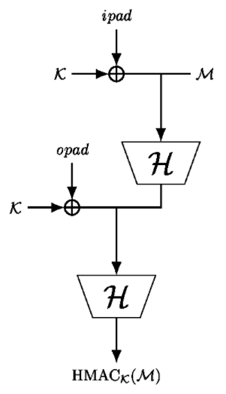
HMAC: Another approach for hashing
(from IACR tikz)

Slide 8
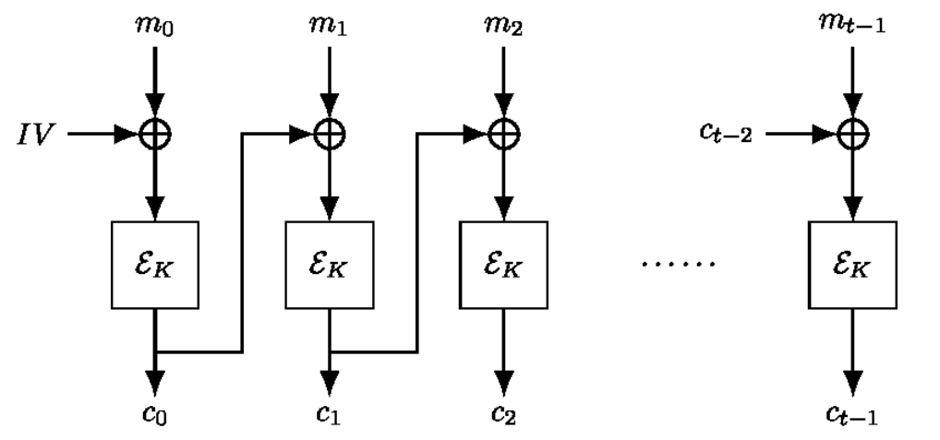
CBC: using a blockcipher
(from IACR tikz)

Slide 9
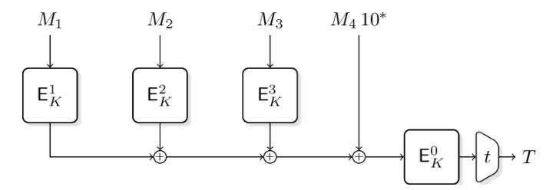
PMAC: using a (tweakable) blockcipher
(from IACR tikz)

Slide 10
Side-channel attacks
Differential power analysis: extract the key/secret once it is used to process different inputs/plaintexts/messages
Exact fit
Breaking the IoT
[RSWO17]

Slide 11
What about the others?
same as CBC…

Slide 12
What about the others?
M
N
M
hk·M
h_{hk}
F_{K}
hk·M
h_{hk}
E_{K}
T
T

Slide 13
What about the others?
hk
M₁
M₂
M₂₀₀₀
N
M
…
hk·M₁
hk·M₂
hk·M₂₀₀₀
F_{K}
hk·M
E_{K}
T
T

Slide 14
What about the others?

Slide 15
Implementation-level protections
Masking, shuffling, …
Severe overheads: $N$ cycles $→$ $10N$ or $100N$ cycles [GR17]
PMAC is as dark

Slide 16
Implementation-level protections
Masking, shuffling, …
Severe overheads: $N$ cycles $→$ $10N$ or $100N$ cycles [GR17]
hk·M₁⊕ hk²·M₂⊕…⊕ hk^{m}·M_{m}
E_{K}
O(|M|) protected calls
T

Slide 17
Let us go back to the plain Hash-then-MAC
M
"less efficient" but secretless
H
Only 1 protected call!
E_{K}
[MOSW15,BKP+18]
T

Slide 18
Verification Vrfy(M,T) of MAC
T=Tag_{K}(M)
M
H
Vrfy(M,T₁) $→$ T =? T’
E_{K}
…
Vrfy(M,T₁) $→$ T =? T’
T’=? T

Slide 19
Use the inverse of E [BPPS17]
M
Vrfy(M,T):
H
H(M) =? E_{K}⁻¹(T)
E_{K}
T

Slide 20
Outline
Leakage-resilient message authentication
Birthday security issue
Our proposals

Slide 21
Low-data attack
M
1. Find collision H(M₁)=H(M₂):
T=2^{n/2} (e.g. 2⁶⁴)
2. Ask for Tag_{K}(M₁) $→$ T
3. Then T is also the tag of M₂
T=2^{n/2} (e.g. 2⁶⁴), D=1
H
E_{K}
T

Slide 22
Salvaging by a tweakable blockcipher [BGP+19]
M
Find collision H(M₁)=H(M₂):
T=2^{n} (e.g. 2¹²⁸)
H
H(M)_{R} =? E_{K}⁻¹(H(M)_{L}, T)
$${\tilde{E}}_{K}$$
T

Slide 23
Salvaging using a permutation
But what the crypto lib only has reliable blockcipher implementations?

Slide 24
Outline
Leakage-resilient message authentication
Birthday security issue
Our proposals

Slide 25
We offer blockcipher-based solutions
M
M
H
H
=?
$$E_{K_{1}}$$
$$E_{K}$$
=?
$$E$$
$$E_{K_{2}}$$
T
T

Slide 26
Modular proof is not possible
M
M
H
H
LRW1 [LRW11]
Minematsu
[Min09]
$$E_{K_{1}}$$
$$E_{K}$$
$$E$$
$$E_{K_{2}}$$
LRWHM
RHM
T
T

Slide 27
Security
LRWHM
2^{2n/3} security for E SPRP, H random oracle
2^{78.3} for n=128
RHM
2^{n}/n security for E ideal cipher, H random oracle
2¹²¹ for n=128

Slide 28
Instantiations
E: AES128
H: SHA3
Variant using Keccak-f[400] for fair comparison
Comparison
AES-CBC (O(|M|) masked AES calls)
IsapMAC (one keyless hash + one rate-1 duplex)

Slide 29
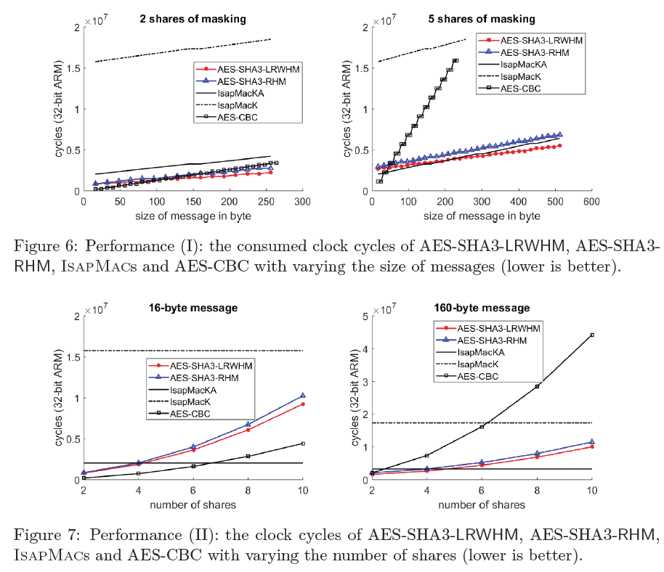
Performance
Outperform the protected AES-CBC as long as the messages are not too short (e.g., more than 50 bytes)
Outperform IsapMacK when the level of side-channel protections is not too strong (i.e., less than 10th order masking)
Comparable to the more aggressive variant IsapMacKA

Slide 30
Comparison
Extremely easy deployment from existing crypto libs with masked cipher (e.g., HACL [ZBPB17])
“inherit” the security of the (well-understood) primitives
IsapMacs
dedicated designs for potentially better efficiency
default implementation resists DPAs

Slide 31
Potential applications
Side-channel secure MAC or AE
E.g., replace AES-CBC in Philips smart lamps to eliminate the side-channel weakness
Evaluation in multi-party computation engines
Replace the plain Hash-then-MAC in CTR-then-HtM [RSS17] for better bounds

Slide 32
Thank you!
Questions or comments?

Slide 33
References
[BKP+18] Francesco Berti, François Koeune, Olivier Pereira, Thomas Peters, and François-Xavier Standaert. Ciphertext integrity with misuse and leakage: Definition and efficient constructions with symmetric primitives. ASIACCS 2018.
[BGM06] Mihir Bellare, Oded Goldreich, and Anton Mityagin. The Power of Verification Queries in Message Authentication and Authenticated Encryption. ePrint 2004/309
[BPPS17] Francesco Berti, Olivier Pereira, Thomas Peters, and François-Xavier Standaert. On leakage-resilient authenticated encryption with decryption leakages. FSE 2017.
[CS16] Benoît Cogliati and Yannick Seurin. EWCDM: An efficient, beyond-birthday secure, nonce-misuse resistant MAC. CRYPTO 2016.
[DDNY18] Nilanjan Datta, Avijit Dutta, Mridul Nandi, and Kan Yasuda. Encrypt or decrypt? To make a single-key beyond birthday secure nonce-based MAC. CRYPTO 2018.
[GR17] Dahmun Goudarzi and Matthieu Rivain. How fast can higher-order masking be in software? Eurocrypt 2017.
[IMPS17] Tetsu Iwata, Kazuhiko Minematsu, Thomas Peyrin, and Yannick Seurin. ZMAC: A fast tweakable block cipher mode for highly secure message authentication. CRYPTO 2017.

Slide 34
References
[LRW11] Moses Liskov, Ronald L. Rivest, and David Wagner. Tweakable block ciphers. Journal of Cryptology, 2011.
[Min09] Kazuhiko Minematsu. Beyond-birthday-bound security based on tweakable block cipher. FSE 2009.
[MOSW15] Daniel P. Martin, Elisabeth Oswald, Martijn Stam, and Marcin Wójcik. A leakage resilient MAC. IMACC 2015.
[RSS17] Dragos Rotaru, Nigel P. Smart, and Martijn Stam. Modes of operation suitable for computing on encrypted data. FSE 2017.
[RSWO17] Eyal Ronen, Adi Shamir, Achi-Or Weingarten, and Colin O’Flynn. IoT goes nuclear: Creating a ZigBee chain reaction. S&P 2017.
[ZBPB17] Jean Karim Zinzindohoué, Karthikeyan Bhargavan, Jonathan Protzenko, and Benjamin Beurdouche. HACL*: A verified modern cryptographic library. CCS 2017.

