Slide 1


KEY ASSIGNMENT SCHEME WITH
AUTHENTICATED ENCRYPTION
–:By:–
Suyash Kandele and Souradyuti Paul
Indian Institute of Technology Bhilai
suyashk@iitbhilai.ac.in and souradyuti@iitbhilai.ac.in
Fast Software Encryption (FSE) 2019
Paris, France
25–28 March 2019

Slide 2

Introduction
Motivation
Problem Statement
KAS-AE Definition
KAS-AE Constructions
Comparison
Conclusion
References
Outline
Introduction
Motivation
Problem Statement
KAS-AE Definition
KAS-AE Constructions
Comparison
Conclusion
References
26th March 2019
Suyash Kandele and Souradyuti Paul | Key Assignment Scheme with Authenticated Encryption | FSE 2019

Slide 3






















Introduction
Motivation
Problem Statement
KAS-AE Definition
KAS-AE Constructions
Comparison
Conclusion
References
Hierarchical Access Control (1)
?
DIRECTOR
?
DEAN (SA)
DEAN (FA)
DEAN (A/C)
DEAN (R&D)
?
FACULTY
FACULTY
FACULTY
FACULTY
FACULTY
STAFF
STAFF
STAFF
STAFF
?
STUDENT
STUDENT
STUDENT
STUDENT
STUDENT
STUDENT
STUDENT
STUDENT
STUDENT
26th March 2019
Suyash Kandele and Souradyuti Paul | Key Assignment Scheme with Authenticated Encryption | FSE 2019
(1)

Slide 4
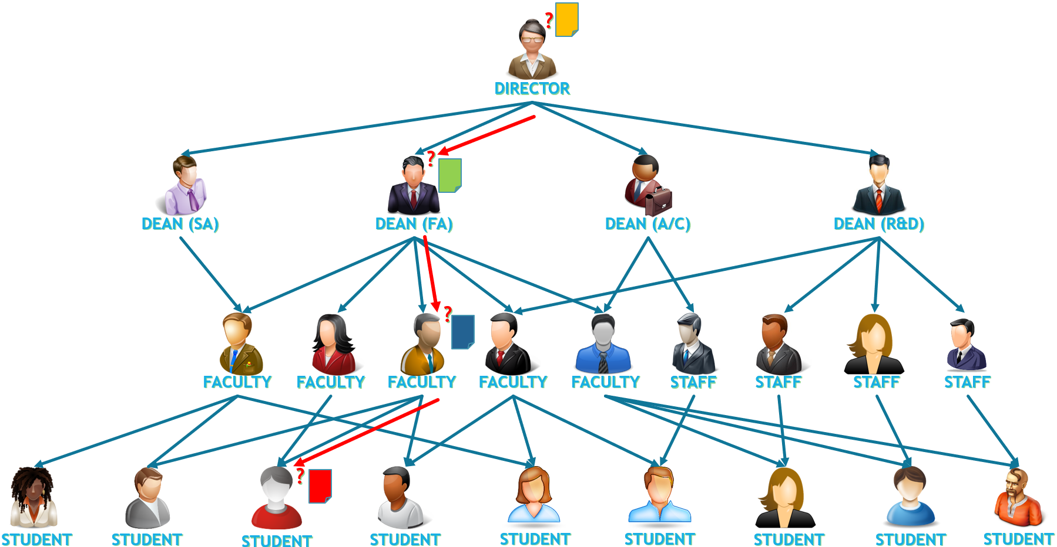
Introduction
Motivation
Problem Statement
KAS-AE Definition
KAS-AE Constructions
Comparison
Conclusion
References
Hierarchical Access Control (2)
STUDENT
FACULTY
DEAN (FA)
DIRECTOR
26th March 2019
Suyash Kandele and Souradyuti Paul | Key Assignment Scheme with Authenticated Encryption | FSE 2019
(2)

Slide 5
Introduction
Motivation
Problem Statement
KAS-AE Definition
KAS-AE Constructions
Comparison
Conclusion
References
Hierarchical Access Control (3)
Providing access to a part of the file and restricting access to unauthorized ones.
Requires:
  Method to generate & retrieve the keys for the accessible part of file.
Deployment In:
  Business and other areas in private sector
Solution:
  Key Assignment Scheme (KAS)
26th March 2019
Suyash Kandele and Souradyuti Paul | Key Assignment Scheme with Authenticated Encryption | FSE 2019
(3)

Slide 6
Introduction
Motivation
Problem Statement
KAS-AE Definition
KAS-AE Constructions
Comparison
Conclusion
References
Key Assignment Scheme (KAS)
A Key Generation Scheme.
The Key required for Encryption and Decryption of a file can be obtained by an authorized user.
Achieves:
  Access Control.
  Privacy (Secrecy).
Applications of KAS:
  Access Control in Hierarchically Structured Organization.
26th March 2019
Suyash Kandele and Souradyuti Paul | Key Assignment Scheme with Authenticated Encryption | FSE 2019
(4)

Slide 7
Introduction
Motivation
Problem Statement
KAS-AE Definition
KAS-AE Constructions
Comparison
Conclusion
References
KAS: Literature Survey
Akl & Taylor (1983) – KAS based on Prime Number
MacKinnon et al. (1985) – Improved KAS based on Prime Number
Harn and Lin (1990) – KAS based on Prime Factorization
Kuo et al. (1999) – KAS based on Rabin cryptosystem and Chinese Remainder Theorem
Tzeng (2002) – Time-bound KAS based on Prime Factorization
Yeh, Chow and Newman (2003) – KAS based on matrix operations
Chien (2003) – KAS based on one-way hash function.
Chang et al. (2004) – KAS based on Discrete Logarithms
Yang and Li (2004) – KAS based on one-way hash function
Atallah, Frikken and Blanton (2005) – KAS based on Hash
Yeh (2005) – RSA based Time-bound KAS
Ateniese (2006) – KAS based on symmetric encryption and bilinear maps
Ateniese et al. (2006) – Time-bound KAS based on symmetric encryption and bilinear maps
Crampton, Martin and Wild (2006) – Generic KAS
Tzeng (2006) – KAS based on modulo exponentiation
Wang and Laih (2006) – Time-bound KAS using merging
Santis, Ferrara and Masucci (2007) – KAS based on a symmetric encryption and broadcast encryption
Bertino, Shang and Wagstaff (2008) – KAS based on ECC
Crampton, Daud and Martin (2010) – KAS based on Chain Partition
FP (2011) – KAS from factoring
26th March 2019
Suyash Kandele and Souradyuti Paul | Key Assignment Scheme with Authenticated Encryption | FSE 2019
(5)

Slide 8
Introduction
Motivation
Problem Statement
KAS-AE Definition
KAS-AE Constructions
Comparison
Conclusion
References
Motivation
Encryption and authentication of data are not an integral part of KAS.
→ Forgery is possible.
So, we need KAS combined with AE.
Is KAS-AE really required as a new primitive or the combination of KAS and AE sufficient?
26th March 2019
Suyash Kandele and Souradyuti Paul | Key Assignment Scheme with Authenticated Encryption | FSE 2019
(6)

Slide 9
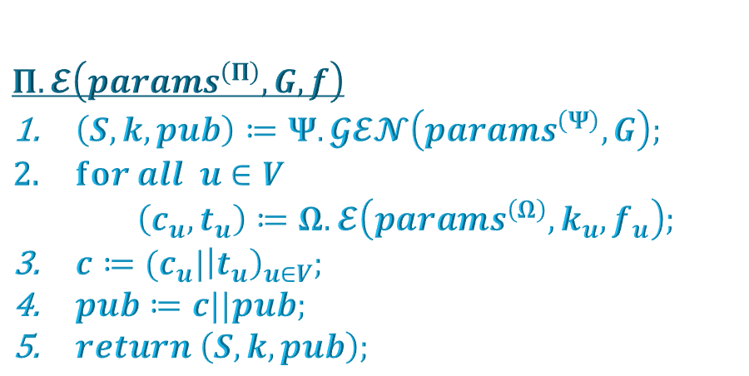

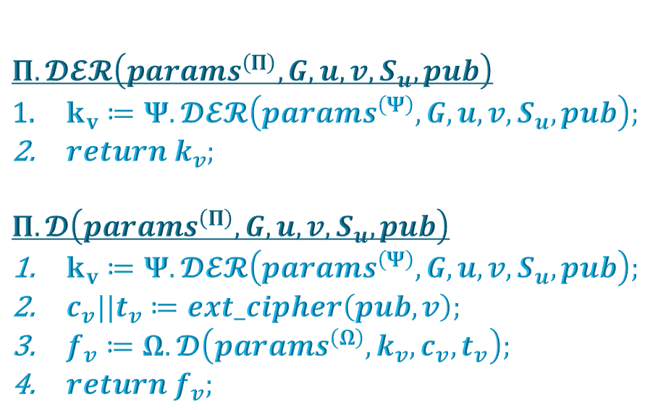
Introduction
Motivation
Problem Statement
KAS-AE Definition
KAS-AE Constructions
Comparison
Conclusion
References
A natural construction: Construction α
A natural KAS-AE scheme $Π=(Π.𝓔,Π.𝓓𝓔𝓡,Π.𝓓)$ constructed using the KAS $Ψ=\left(Ψ.𝓖𝓔𝓝,Ψ.𝓓𝓔𝓡\right)$ and the AE scheme $Ω=(Ω.𝓚_{GEN},Ω.𝓔,Ω.𝓓)$.
$$Π.𝓔\left(params^{\left(Π\right)},G,f\right)$$
  $\left(S,k,pub\right)≔Ψ.𝓖𝓔𝓝\left(params^{\left(Ψ\right)},G\right);$
  $for all u∈V$
      $\left(c_{u},t_{u}\right)≔Ω.𝓔\left(params^{\left(Ω\right)},k_{u},f_{u}\right);$
  $c≔(c_{u}|{\left|t_{u}\right)}_{u∈V};$
  $pub≔c||pub;$
  $return \left(S,k,pub\right);$
  $$Π.𝓓𝓔𝓡\left(params^{\left(Π\right)},G,u,v,S_{u},pub\right)$$
  $k_{v}≔Ψ.𝓓𝓔𝓡\left(params^{\left(Ψ\right)},G,u,v,S_{u},pub\right);$
  $return k_{v};$
  $$Π.𝓓\left(params^{\left(Π\right)},G,u,v,S_{u},pub\right)$$
  $k_{v}≔Ψ.𝓓𝓔𝓡\left(params^{\left(Ψ\right)},G,u,v,S_{u},pub\right);$
  $c_{v}||t_{v}≔ext_cipher\left(pub,v\right);$
  $f_{v}≔Ω.𝓓\left(params^{\left(Ω\right)},k_{v},c_{v},t_{v}\right);$
  $return f_{v};$
26th March 2019
Suyash Kandele and Souradyuti Paul | Key Assignment Scheme with Authenticated Encryption | FSE 2019
(7)

Slide 10



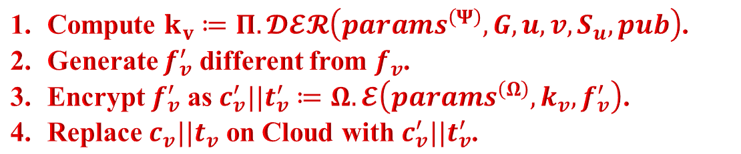


Introduction
Motivation
Problem Statement
KAS-AE Definition
KAS-AE Constructions
Comparison
Conclusion
References
An attack on Construction α
$$Π.𝓔\left(params^{\left(Π\right)},G,f\right)$$
  $\left(S,k,pub\right)≔Ψ.𝓖𝓔𝓝\left(params^{\left(Ψ\right)},G\right);$
  $for all u∈V$
      $\left(c_{u},t_{u}\right)≔Ω.𝓔\left(params^{\left(Ω\right)},k_{u},f_{u}\right);$
  $c≔(c_{u}|{\left|t_{u}\right)}_{u∈V};$
  $pub≔c||pub;$
  $return \left(S,k,pub\right);$
  $$Π.𝓓𝓔𝓡\left(params^{\left(Π\right)},G,u,v,S_{u},pub\right)$$
  $k_{v}≔Ψ.𝓓𝓔𝓡\left(params^{\left(Ψ\right)},G,u,v,S_{u},pub\right);$
  $return k_{v};$
  $$Π.𝓓\left(params^{\left(Π\right)},G,u,v,S_{u},pub\right)$$
  $k_{v}≔Ψ.𝓓𝓔𝓡\left(params^{\left(Ψ\right)},G,u,v,S_{u},pub\right);$
  $c_{v}||t_{v}≔ext_cipher\left(pub,v\right);$
  $f_{v}≔Ω.𝓓\left(params^{\left(Ω\right)},k_{v},c_{v},t_{v}\right);$
  $return f_{v};$
  $$(k_{u},S_{u})$$
  User $u$
  Compute $k_{v}≔Π.𝓓𝓔𝓡\left(params^{\left(Ψ\right)},G,u,v,S_{u},pub\right)$.
  Generate $f_{v}^{′}$ different from $f_{v}$.
  Encrypt $f_{v}^{′}$ as $c_{v}^{′}||t_{v}^{′}≔Ω.𝓔\left(params^{\left(Ω\right)}, k_{v},f_{v}^{′}\right)$.
  Replace $c_{v}||t_{v}$ on Cloud with $c_{v}^{′}||t_{v}^{′}$.
  User $v$
26th March 2019
Suyash Kandele and Souradyuti Paul | Key Assignment Scheme with Authenticated Encryption | FSE 2019
(8)

Slide 11
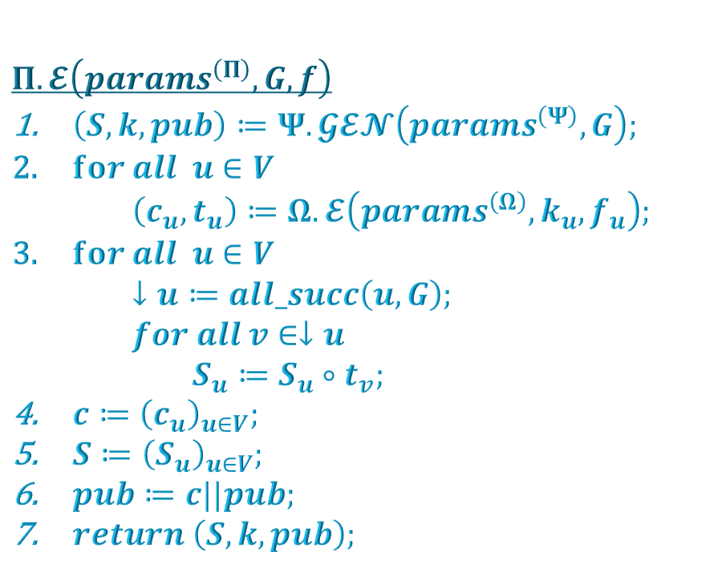
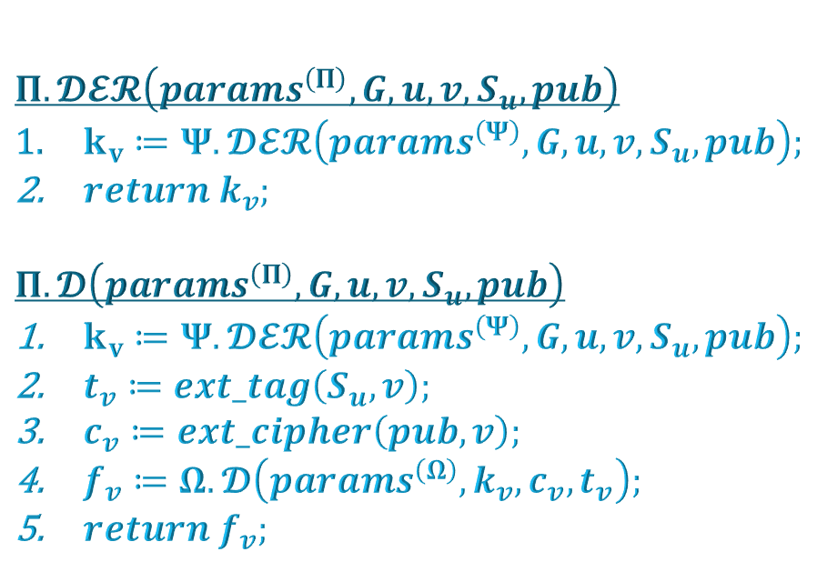
Introduction
Motivation
Problem Statement
KAS-AE Definition
KAS-AE Constructions
Comparison
Conclusion
References
A secure construction: Construction β
A natural KAS-AE scheme $Π=(Π.𝓔,Π.𝓓𝓔𝓡,Π.𝓓)$ constructed using the KAS $Ψ=\left(Ψ.𝓖𝓔𝓝,Ψ.𝓓𝓔𝓡\right)$ and the AE scheme $Ω=(Ω.𝓚_{GEN},Ω.𝓔,Ω.𝓓)$.
$$Π.𝓔\left(params^{\left(Π\right)},G,f\right)$$
  $\left(S,k,pub\right)≔Ψ.𝓖𝓔𝓝\left(params^{\left(Ψ\right)},G\right);$
  $for all u∈V$
      $\left(c_{u},t_{u}\right)≔Ω.𝓔\left(params^{\left(Ω\right)},k_{u},f_{u}\right);$
  $for all u∈V$
      $↓u≔all_succ\left(u,G\right);$
      $for all v∈↓u$
      $S_{u}≔S_{u}∘t_{v};$
  $c≔{\left(c_{u}\right)}_{u∈V};$
  $S≔{\left(S_{u}\right)}_{u∈V};$
  $pub≔c||pub;$
  $return \left(S,k,pub\right);$
  $$Π.𝓓𝓔𝓡\left(params^{\left(Π\right)},G,u,v,S_{u},pub\right)$$
  $k_{v}≔Ψ.𝓓𝓔𝓡\left(params^{\left(Ψ\right)},G,u,v,S_{u},pub\right);$
  $return k_{v};$
  $$Π.𝓓\left(params^{\left(Π\right)},G,u,v,S_{u},pub\right)$$
  $k_{v}≔Ψ.𝓓𝓔𝓡\left(params^{\left(Ψ\right)},G,u,v,S_{u},pub\right);$
  $t_{v}≔ext_tag\left(S_{u},v\right);$
  $c_{v}≔ext_cipher\left(pub,v\right);$
  $f_{v}≔Ω.𝓓\left(params^{\left(Ω\right)},k_{v},c_{v},t_{v}\right);$
  $return f_{v};$
  Memory Inefficient
26th March 2019
Suyash Kandele and Souradyuti Paul | Key Assignment Scheme with Authenticated Encryption | FSE 2019
(9)

Slide 12
Introduction
Motivation
Problem Statement
KAS-AE Definition
KAS-AE Constructions
Comparison
Conclusion
References
Problem Statement
Encryption and authentication of data are not an integral part of KAS
→ Forgery is possible.
So, we need KAS combined with AE.
→ Trivial combination is insecure.
→ Secure combination is Memory Inefficient.
Can we construct a secure KAS-AE scheme that solves HAC problem more efficiently than the simple combination of KAS and AE executed in that order?
26th March 2019
Suyash Kandele and Souradyuti Paul | Key Assignment Scheme with Authenticated Encryption | FSE 2019
(10)

Slide 13
Introduction
Motivation
Problem Statement
KAS-AE Definition
KAS-AE Constructions
Comparison
Conclusion
References
Overview
Key Assignment Scheme with Authenticated Encryption
A Key Generation Scheme.
The Key required for Encryption and Decryption of a file can be obtained by an authorized user.
The message encryption and authentication is an integral part.
Achieves:
  Access Control.
  Privacy.
  Integrity.
  Authenticity.
26th March 2019
Suyash Kandele and Souradyuti Paul | Key Assignment Scheme with Authenticated Encryption | FSE 2019
(11)

Slide 14
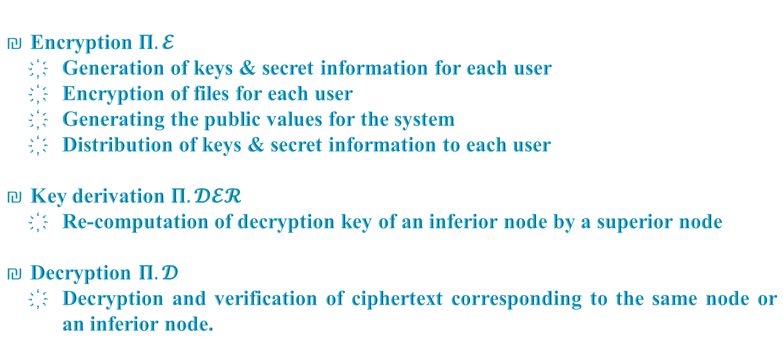
Introduction
Motivation
Problem Statement
KAS-AE Definition
KAS-AE Constructions
Comparison
Conclusion
References
Functionalities
Encryption $Π.𝓔$
  Generation of keys & secret information for each user
  Encryption of files for each user
  Generating the public values for the system
  Distribution of keys & secret information to each user
Key derivation $Π.𝓓𝓔𝓡$
  Re-computation of decryption key of an inferior node by a superior node
Decryption $Π.𝓓$
  Decryption and verification of ciphertext corresponding to the same node or an inferior node.
26th March 2019
Suyash Kandele and Souradyuti Paul | Key Assignment Scheme with Authenticated Encryption | FSE 2019
(12)

Slide 15
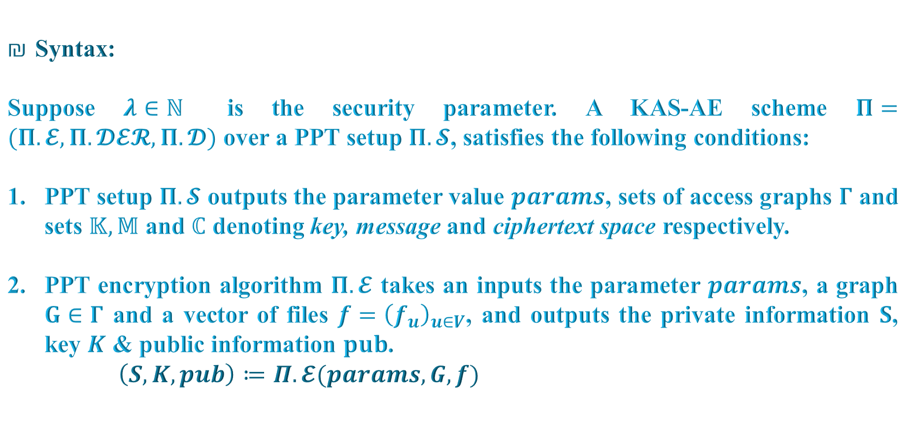
Introduction
Motivation
Problem Statement
KAS-AE Definition
KAS-AE Constructions
Comparison
Conclusion
References
Formal Definition (1)
Syntax:
Suppose $λ∈ℕ$ is the security parameter. A KAS-AE scheme $Π=(Π.𝓔,Π.𝓓𝓔𝓡,Π.𝓓)$ over a PPT setup $Π.𝓢$, satisfies the following conditions:
PPT setup $Π.𝓢$ outputs the parameter value $params$, sets of access graphs $Γ$ and sets $𝕂, 𝕄$ and $ℂ$ denoting key, message and ciphertext space respectively.
PPT encryption algorithm $Π.𝓔$ takes an inputs the parameter $params$, a graph $G∈Γ$ and a vector of files $f={\left(f_{u}\right)}_{u∈V}$, and outputs the private information $S$, key $K$ & public information $pub$.
  $\left(S,K,pub\right)≔Π.𝓔(params, G,f)$
26th March 2019
Suyash Kandele and Souradyuti Paul | Key Assignment Scheme with Authenticated Encryption | FSE 2019
(13)

Slide 16
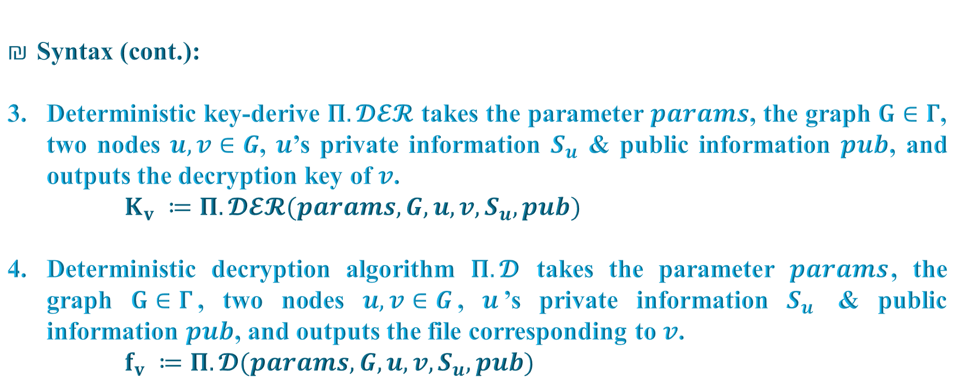
Introduction
Motivation
Problem Statement
KAS-AE Definition
KAS-AE Constructions
Comparison
Conclusion
References
Formal Definition (2)
Syntax (cont.):
Deterministic key-derive $Π.𝓓𝓔𝓡$ takes the parameter $params$, the graph $G∈Γ$, two nodes $u,v∈G$, $u$’s private information $S_{u}$ & public information $pub$, and outputs the decryption key of $v$.
  $K_{v} ≔Π.𝓓𝓔𝓡(params,G,u,v,S_{u},pub)$
Deterministic decryption algorithm $Π.𝓓$ takes the parameter $params$, the graph $G∈Γ$, two nodes $u,v∈G$, $u$’s private information $S_{u}$ & public information $pub$, and outputs the file corresponding to $v$.
  $f_{v} ≔Π.𝓓(params,G,u,v,S_{u},pub)$
26th March 2019
Suyash Kandele and Souradyuti Paul | Key Assignment Scheme with Authenticated Encryption | FSE 2019
(14)

Slide 17
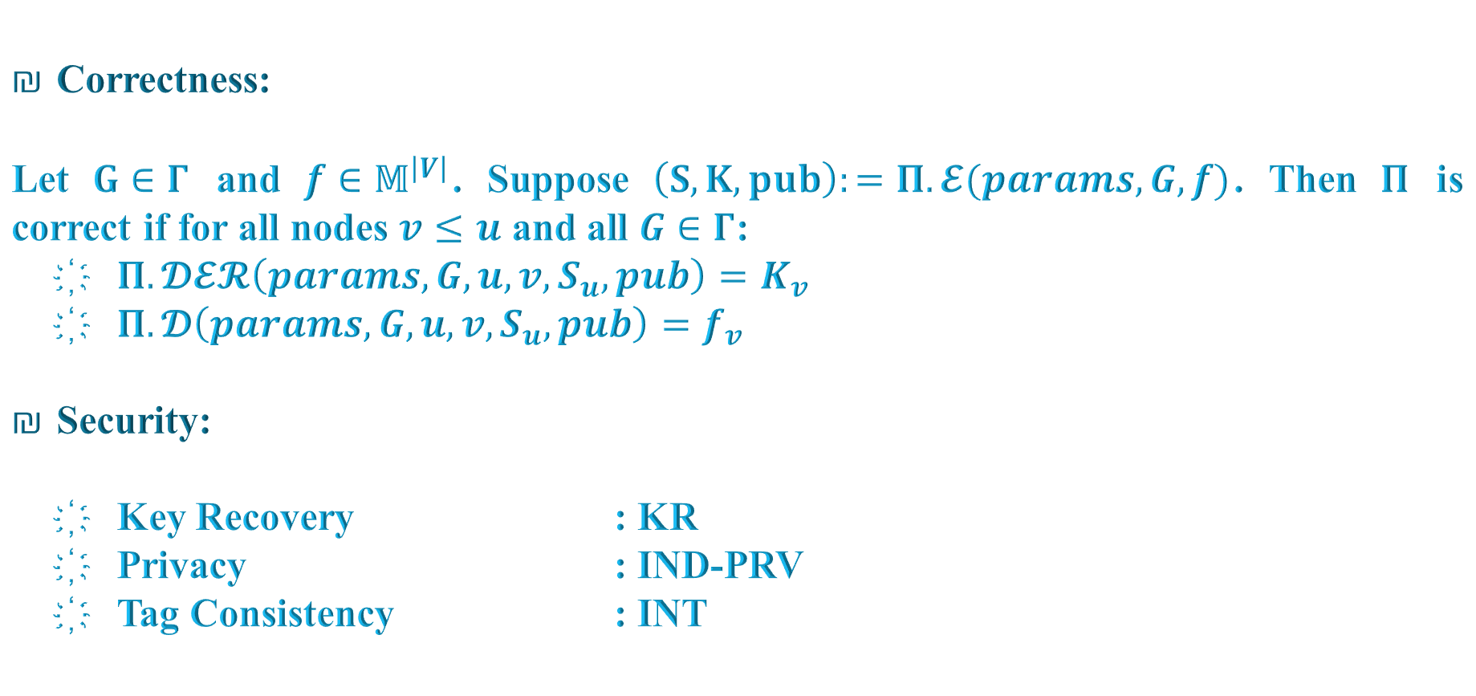
Introduction
Motivation
Problem Statement
KAS-AE Definition
KAS-AE Constructions
Comparison
Conclusion
References
Formal Definition (3)
Correctness:
Let $G∈Γ$ and $f∈𝕄^{\left|V\right|}$. Suppose $\left(S,K,pub\right):=Π.𝓔(params,G,f)$. Then $Π$ is correct if for all nodes $v≤u$ and all $G∈Γ$:
  $Π.𝓓𝓔𝓡\left(params,G,u,v,S_{u},pub\right)=K_{v}$
  $Π.𝓓\left(params,G,u,v,S_{u},pub\right)=f_{v}$
Security:
  Key Recovery : KR
  Privacy : IND-PRV
  Tag Consistency : INT
26th March 2019
Suyash Kandele and Souradyuti Paul | Key Assignment Scheme with Authenticated Encryption | FSE 2019
(15)

Slide 18
Introduction
Motivation
Problem Statement
KAS-AE Definition
KAS-AE Constructions
Comparison
Conclusion
References
Method-1: Constructing KAS-AE from KAS-AE-chain
Ingredients:
  KAS-AE-chain scheme
    Special type of KAS-AE, where the access graph is a totally ordered set.
  Modified chain partition algorithm
    Partition the access graph into disjoint chains
    Design KAS-AE-chains corresponding to these chains.
    Securely join these KAS-AE-chains to form the KAS-AE for the full access graph.
Proposed Constructions:
  Construction A (Based on KAS-chain and AE)
  Construction B (Based on MLE)
  Construction C (Based on APE Authenticated Encryption)
  Construction D (Based on FP Hash Mode of Operation)
26th March 2019
Suyash Kandele and Souradyuti Paul | Key Assignment Scheme with Authenticated Encryption | FSE 2019
(16)

Slide 19
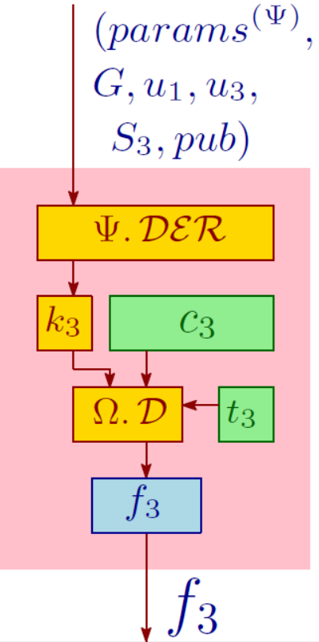
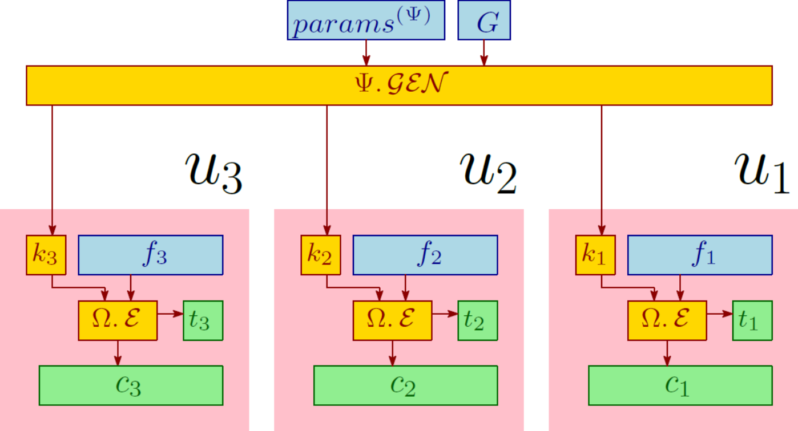
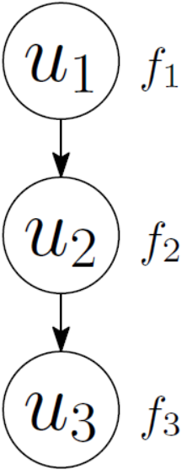
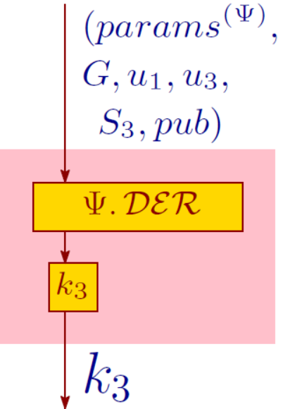

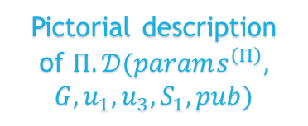
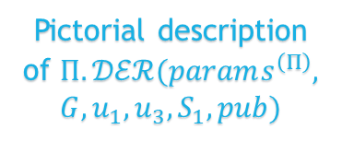
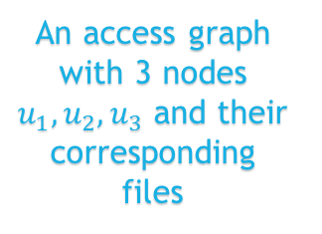

Introduction
Motivation
Problem Statement
KAS-AE Definition
KAS-AE Constructions
Comparison
Conclusion
References
KAS-AE-chain: Construction $A_{Chain}$
KAS-chain $Ψ=\left(Ψ.𝓖𝓔𝓝,Ψ.𝓓𝓔𝓡\right)$ and AE $Ω=(Ω.𝓚_{GEN},Ω.𝓔,Ω.𝓓)$.
An access graph with 3 nodes $u_{1},u_{2},u_{3}$ and their corresponding files
Pictorial description of $Π.ℰ(params^{\left(Π\right)},G,f)$, where $f=(f_{1}∘f_{2}∘f_{3})$ and G is shown on the left hand side
Pictorial description of $Π.𝒟ℰℛ(params^{\left(Π\right)},$
$$G,u_{1},u_{3},S_{1},pub)$$
Pictorial description of $Π.𝒟(params^{\left(Π\right)},$
$$G,u_{1},u_{3},S_{1},pub)$$
26th March 2019
Suyash Kandele and Souradyuti Paul | Key Assignment Scheme with Authenticated Encryption | FSE 2019
(17)

Slide 20
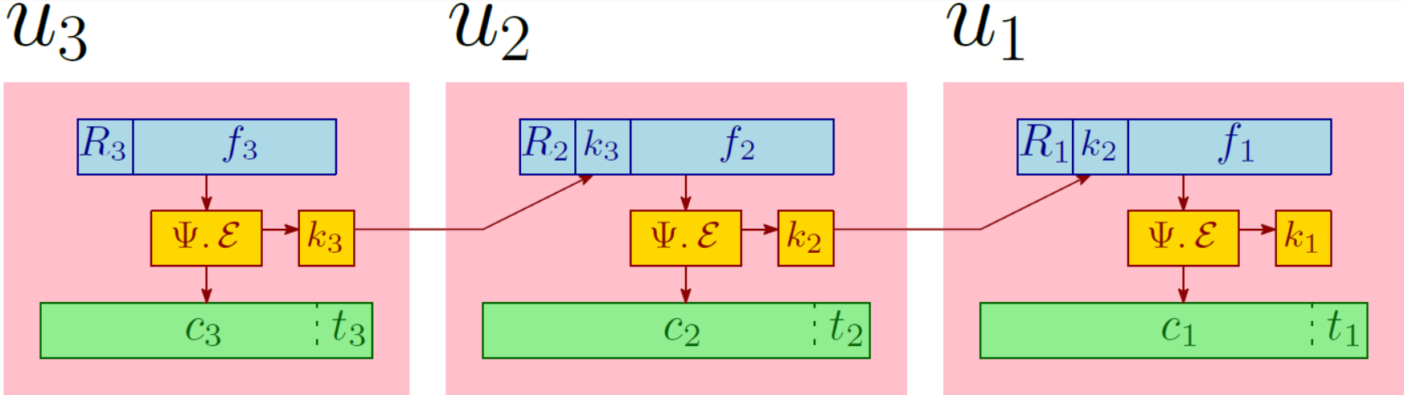
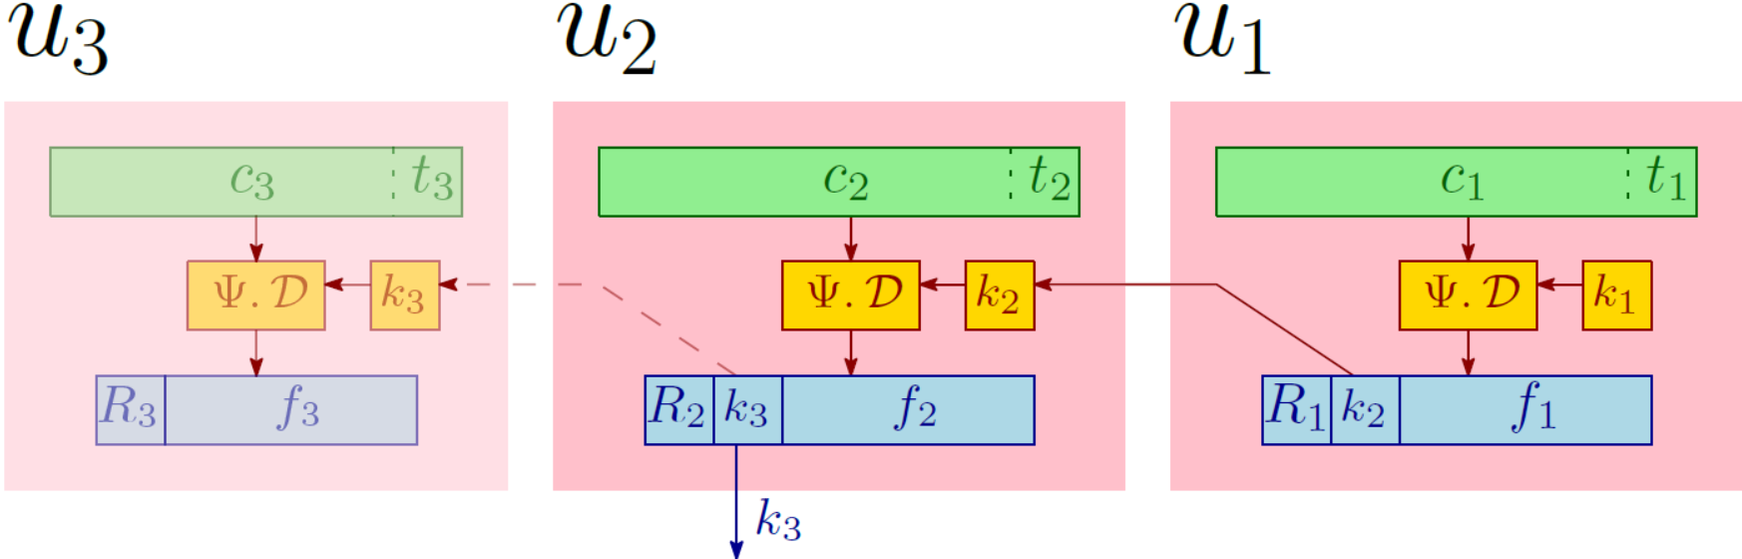
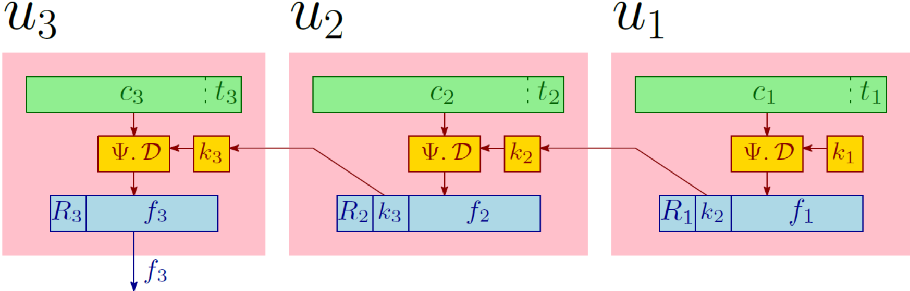





Introduction
Motivation
Problem Statement
KAS-AE Definition
KAS-AE Constructions
Comparison
Conclusion
References
KAS-AE-chain: Construction $B_{Chain}$
MLE $Ψ=\left(Ψ.𝓔,Ψ.𝓓\right)$.
An access graph with 3 nodes $u_{1},u_{2},u_{3}$ and their corresponding files
Pictorial description of $Π.ℰ(params^{\left(Π\right)},G,f)$, where $f=(f_{1}∘f_{2}∘f_{3})$ and G is shown on the left hand side
Pictorial description of $Π.𝒟ℰℛ(params^{\left(Π\right)},$
$$G,u_{1},u_{3},S_{1},pub)$$
Pictorial description of $Π.𝒟(params^{\left(Π\right)},$
$$G,u_{1},u_{3},S_{1},pub)$$
26th March 2019
Suyash Kandele and Souradyuti Paul | Key Assignment Scheme with Authenticated Encryption | FSE 2019
(18)

Slide 21
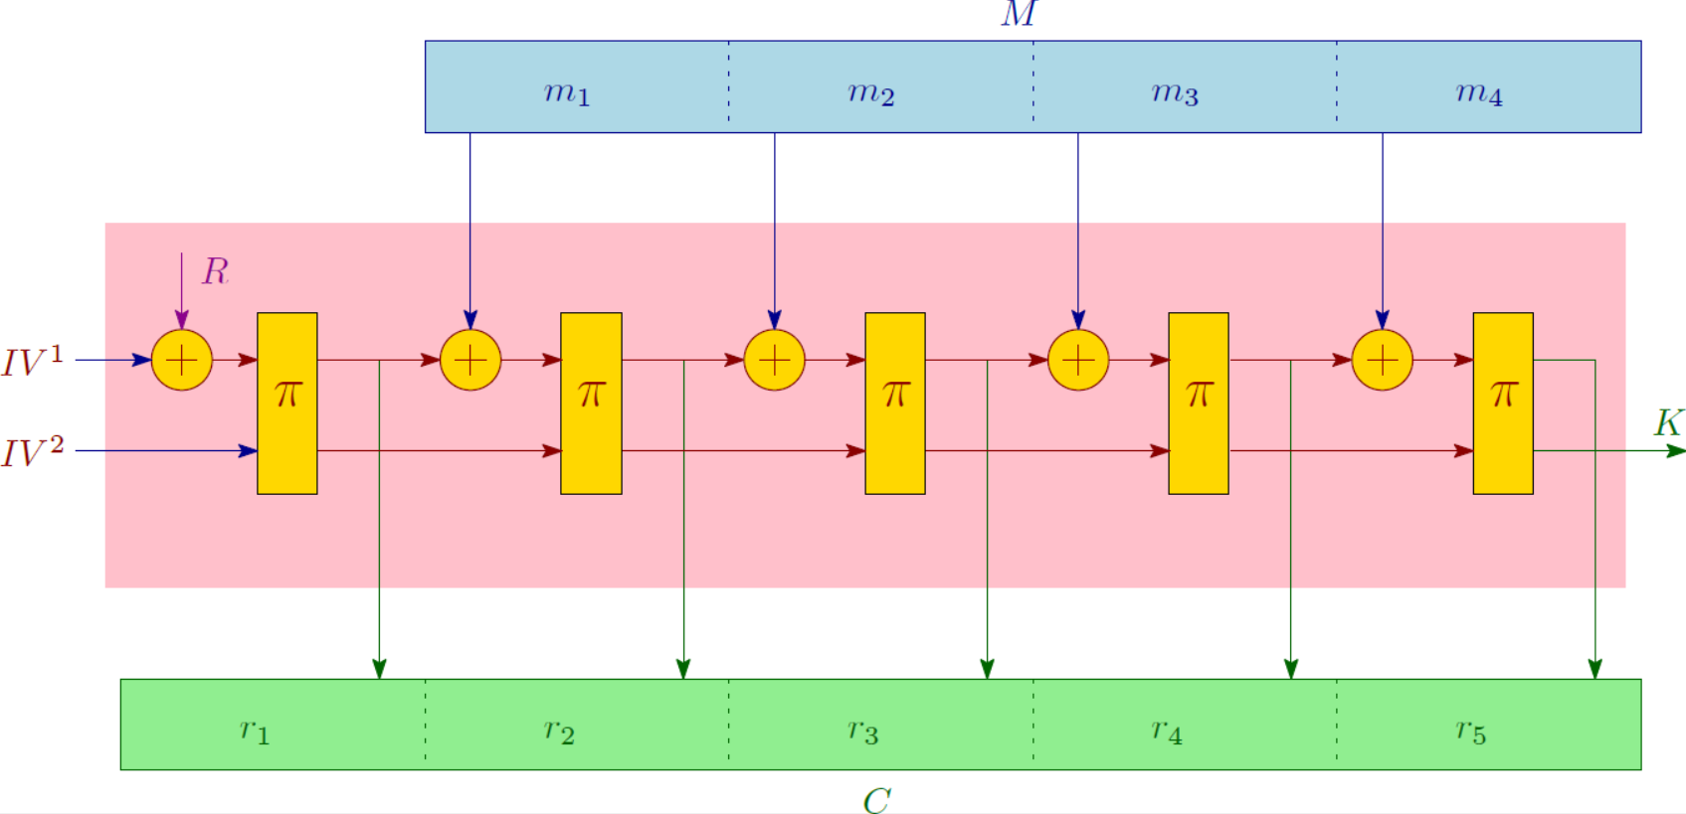
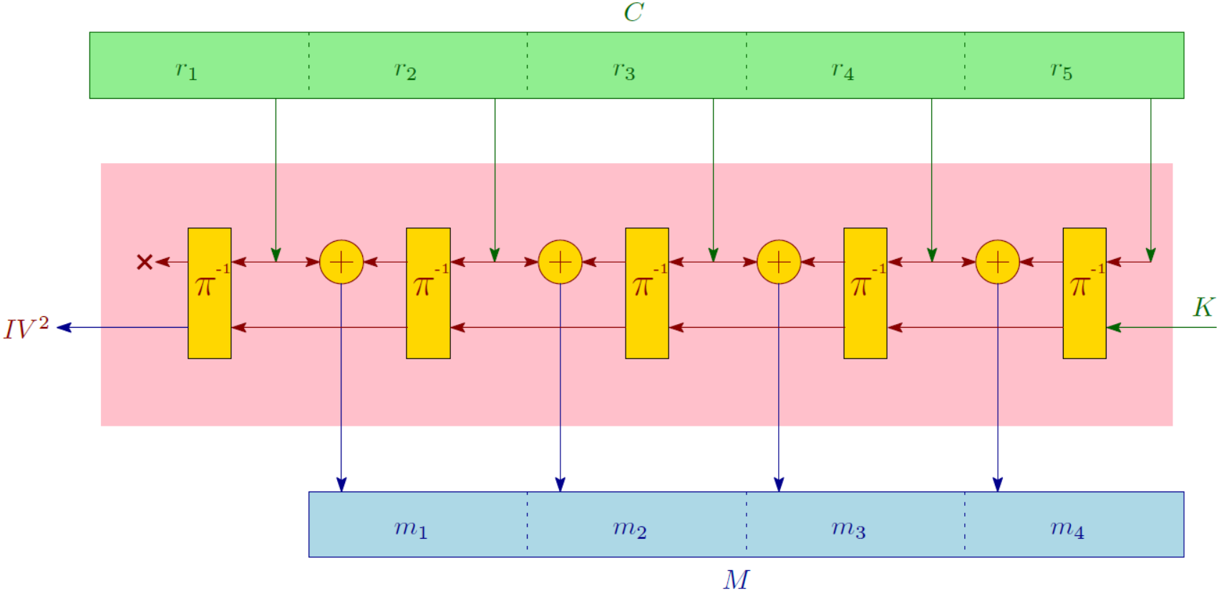


Introduction
Motivation
Problem Statement
KAS-AE Definition
KAS-AE Constructions
Comparison
Conclusion
References
KAS-AE-chain: Construction $C_{Chain}$ (1)
Functionalities $𝓕_{1}$ and $𝓕_{2}$ based on APE Authenticated Encryption.
  [Andreeva et al. FSE-2014]
Pictorial description of Functionality $ℱ_{1}$
Pictorial description of Functionality $ℱ_{2}$
26th March 2019
Suyash Kandele and Souradyuti Paul | Key Assignment Scheme with Authenticated Encryption | FSE 2019
(19)

Slide 22
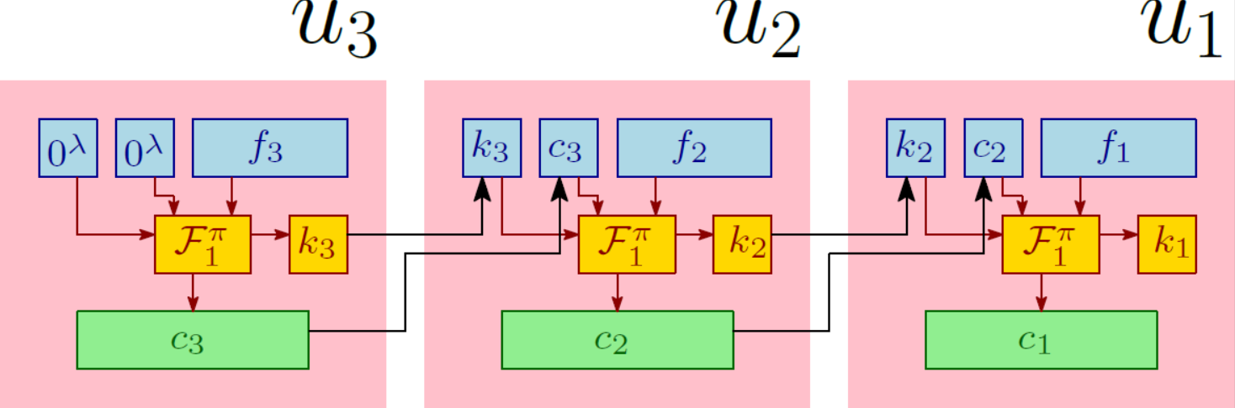
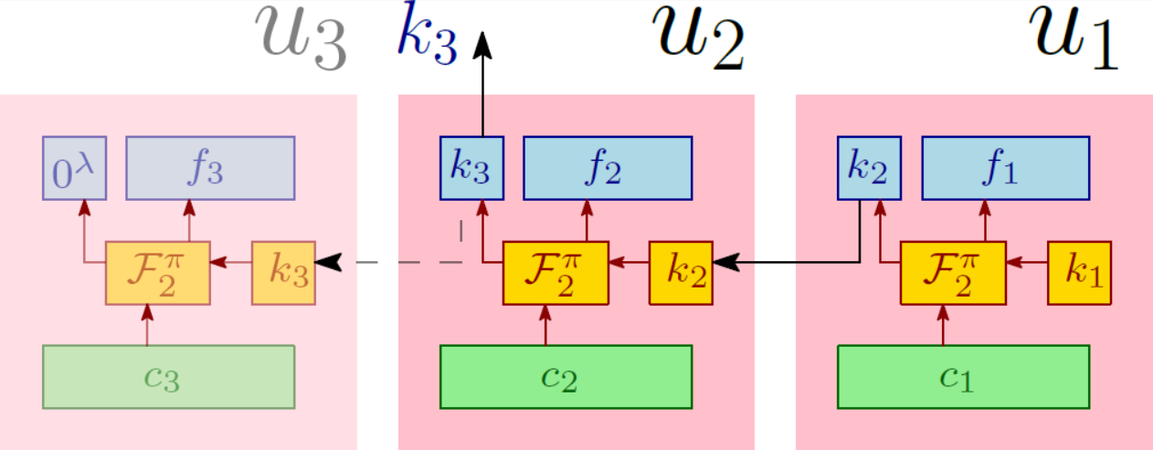
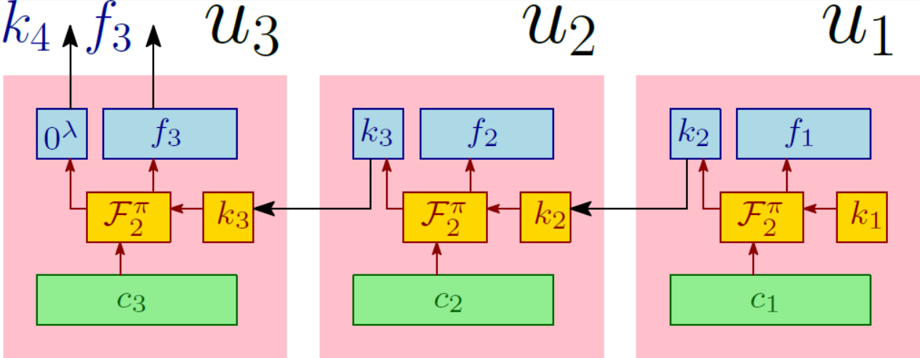





Introduction
Motivation
Problem Statement
KAS-AE Definition
KAS-AE Constructions
Comparison
Conclusion
References
KAS-AE-chain: Construction $C_{Chain}$ (2)
An access graph with 3 nodes $u_{1},u_{2},u_{3}$ and their corresponding files
Pictorial description of $Π.ℰ(params^{\left(Π\right)},G,f)$, where $f=(f_{1}∘f_{2}∘f_{3})$ and G is shown on the left hand side
Pictorial description of $Π.𝒟ℰℛ(params^{\left(Π\right)},$
$$G,u_{1},u_{3},S_{1},pub)$$
Pictorial description of $Π.𝒟(params^{\left(Π\right)},$
$$G,u_{1},u_{3},S_{1},pub)$$
26th March 2019
Suyash Kandele and Souradyuti Paul | Key Assignment Scheme with Authenticated Encryption | FSE 2019
(20)

Slide 23
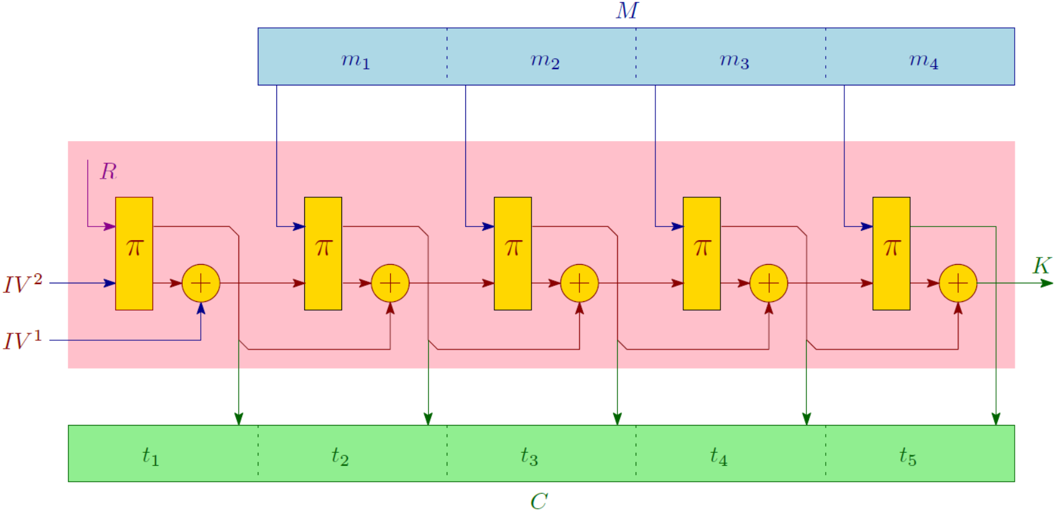
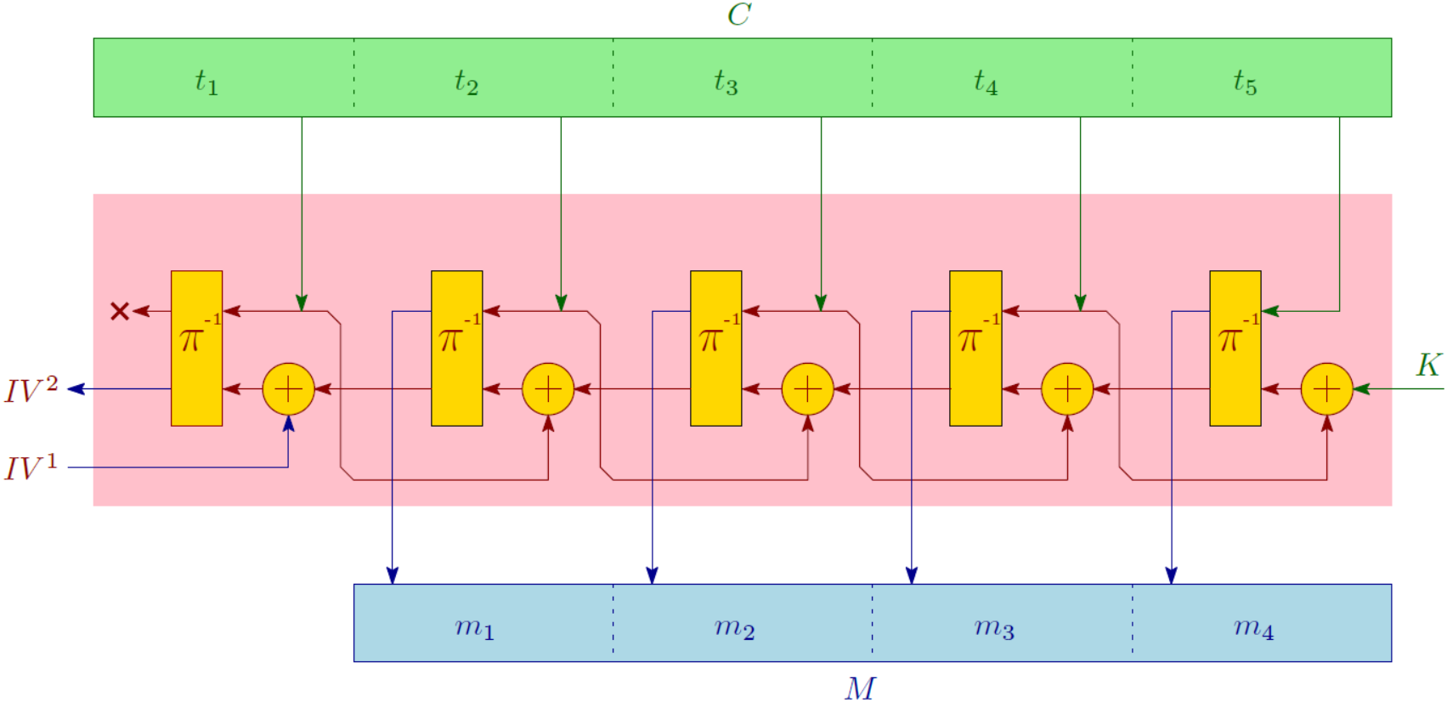


Introduction
Motivation
Problem Statement
KAS-AE Definition
KAS-AE Constructions
Comparison
Conclusion
References
KAS-AE-chain: Construction $D_{Chain}$ (1)
Functionalities $𝓖_{1}$ and $𝓖_{2}$ based on FP Hash Mode of Operation.
              [Paul, Homsirikamol and Gaj, Indocrypt-2012]
Pictorial description of Functionality $𝒢_{1}$
Pictorial description of Functionality $𝒢_{2}$
26th March 2019
Suyash Kandele and Souradyuti Paul | Key Assignment Scheme with Authenticated Encryption | FSE 2019
(21)

Slide 24
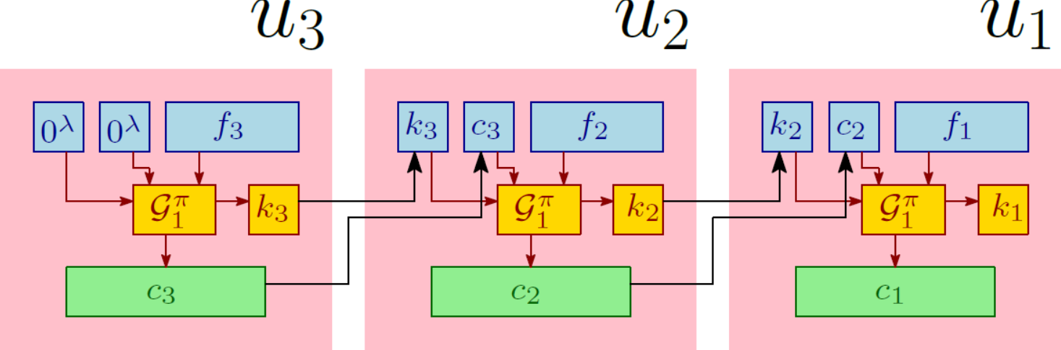
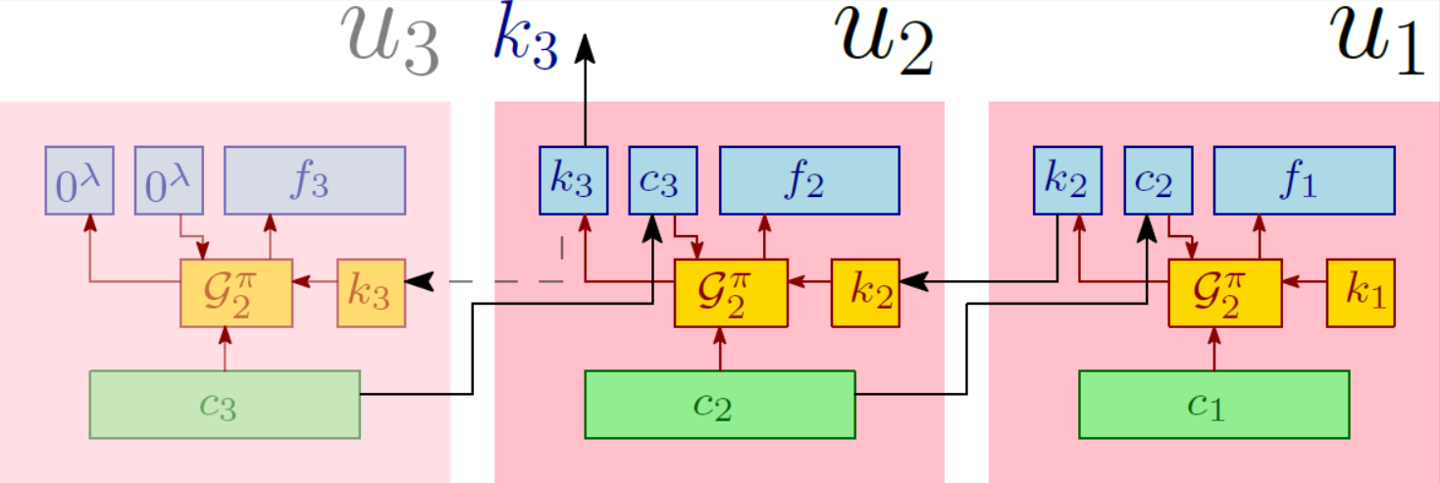
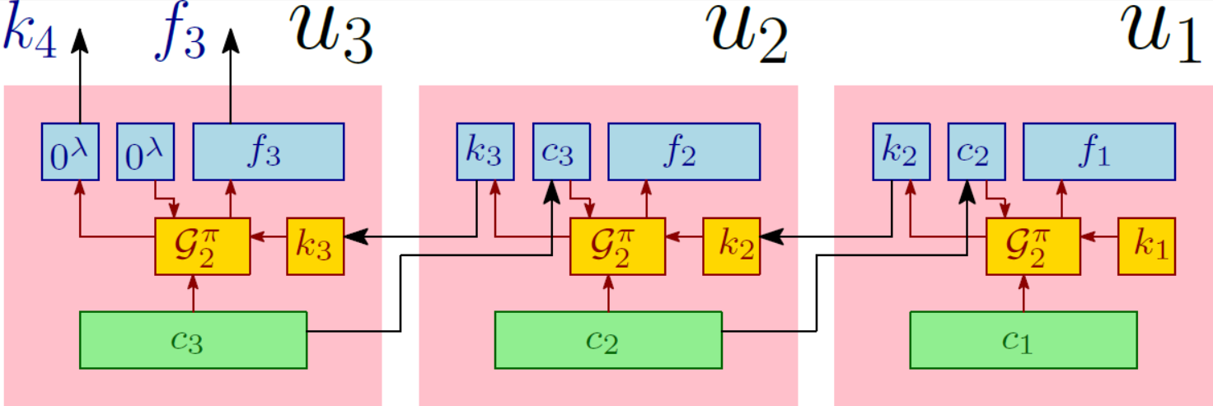

Introduction
Motivation
Problem Statement
KAS-AE Definition
KAS-AE Constructions
Comparison
Conclusion
References
KAS-AE-chain: Construction $D_{Chain}$ (2)
An access graph with 3 nodes $u_{1},u_{2},u_{3}$ and their corresponding files
Pictorial description of $Π.ℰ(params^{\left(Π\right)},G,f)$, where $f=(f_{1}∘f_{2}∘f_{3})$ and G is shown on the left hand side
Pictorial description of $Π.𝒟ℰℛ(params^{\left(Π\right)},$
$$G,u_{1},u_{3},S_{1},pub)$$
Pictorial description of $Π.𝒟(params^{\left(Π\right)},$
$$G,u_{1},u_{3},S_{1},pub)$$
26th March 2019
Suyash Kandele and Souradyuti Paul | Key Assignment Scheme with Authenticated Encryption | FSE 2019
(22)

Slide 25
Introduction
Motivation
Problem Statement
KAS-AE Definition
KAS-AE Constructions
Comparison
Conclusion
References
Method-2: Constructing KAS-AE from scratch.
Proposed Constructions:
  Construction 1 (Based on MLE)
  Construction 2 (Based on APE Authenticated Encryption)
  Construction 3 (Based on FP Hash Mode of Operation)
26th March 2019
Suyash Kandele and Souradyuti Paul | Key Assignment Scheme with Authenticated Encryption | FSE 2019
(23)

Slide 26
Introduction
Motivation
Problem Statement
KAS-AE Definition
KAS-AE Constructions
Comparison
Conclusion
References
Construction 1
Based on Message-Locked Encryption (MLE)
Idea: Encrypting the decryption keys of immediate children of the node along with the files of the node
Advantage:
  Decryption keys for the immediate children nodes are obtained on decryption.
  MLE takes care of authentication and encryption together via the decryption key, so we do not need to store the tags for the file.
26th March 2019
Suyash Kandele and Souradyuti Paul | Key Assignment Scheme with Authenticated Encryption | FSE 2019
(24)

Slide 27
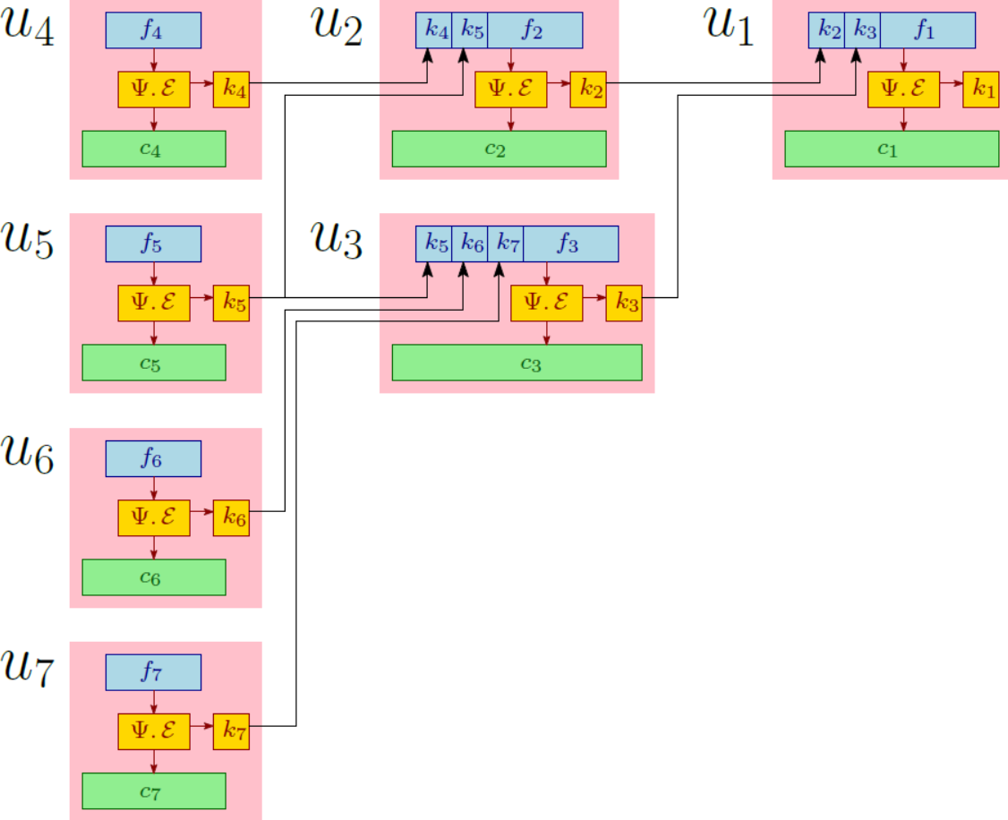
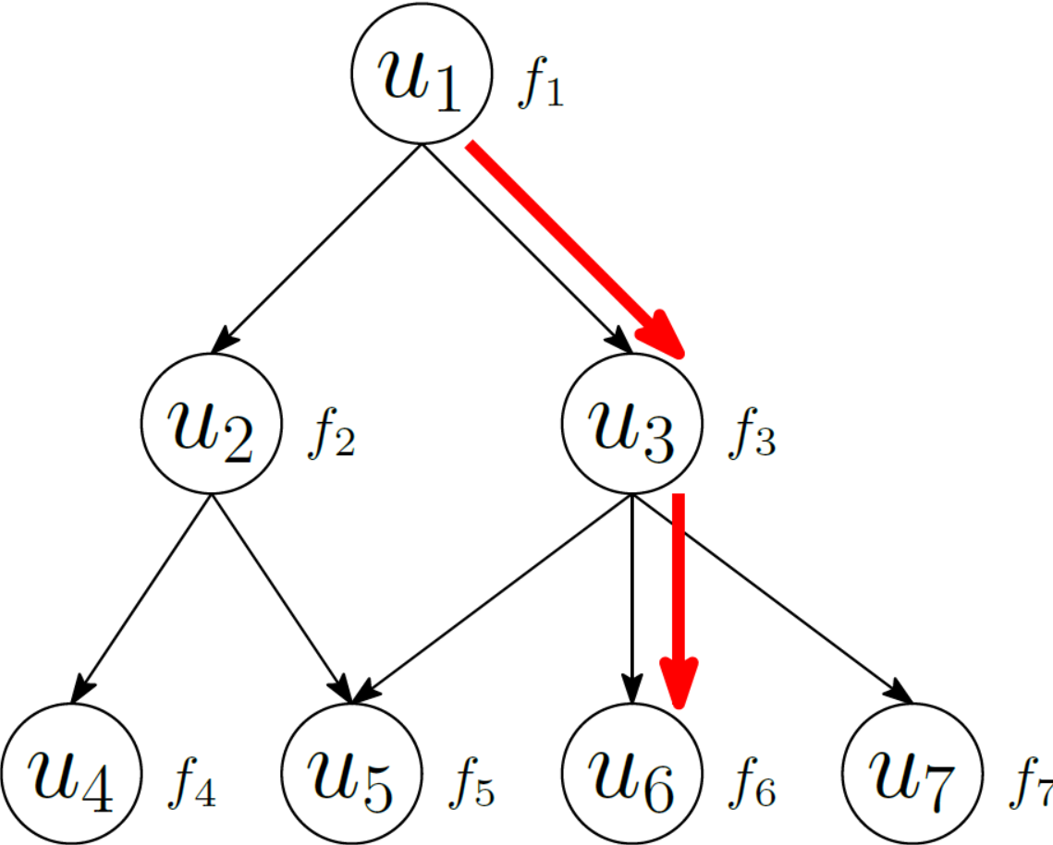
Introduction
Motivation
Problem Statement
KAS-AE Definition
KAS-AE Constructions
Comparison
Conclusion
References
Construction 1: Encryption
Reference Tree
26th March 2019
Suyash Kandele and Souradyuti Paul | Key Assignment Scheme with Authenticated Encryption | FSE 2019
(25)

Slide 28
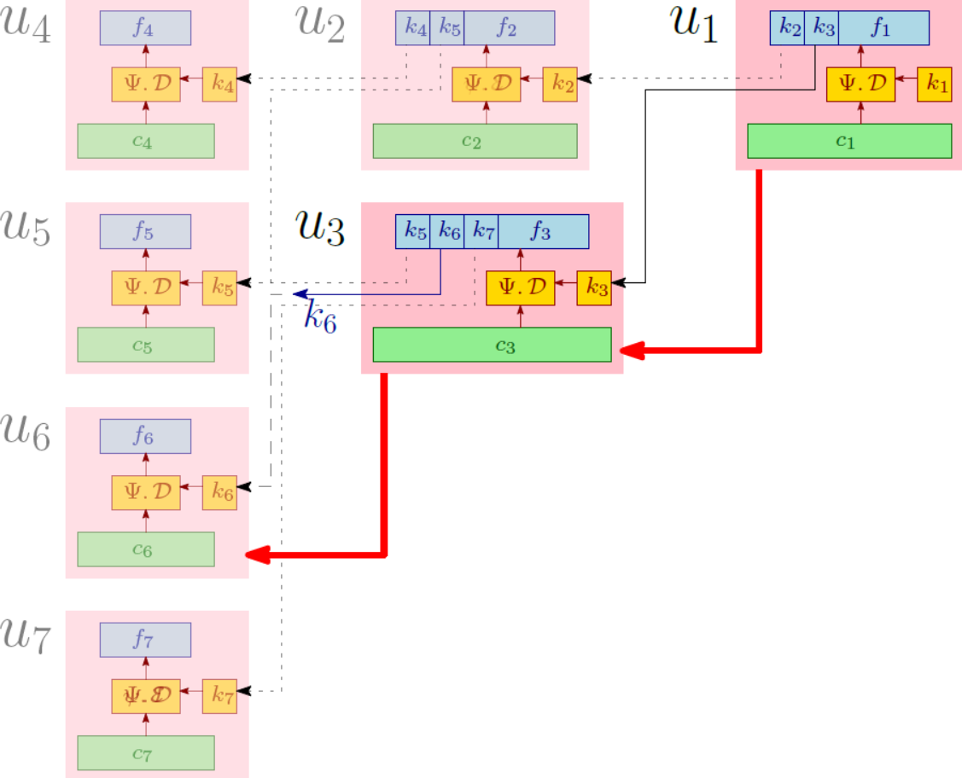
Introduction
Motivation
Problem Statement
KAS-AE Definition
KAS-AE Constructions
Comparison
Conclusion
References
Construction 1: Key Derivation
Reference Tree
26th March 2019
Suyash Kandele and Souradyuti Paul | Key Assignment Scheme with Authenticated Encryption | FSE 2019
(26)

Slide 29
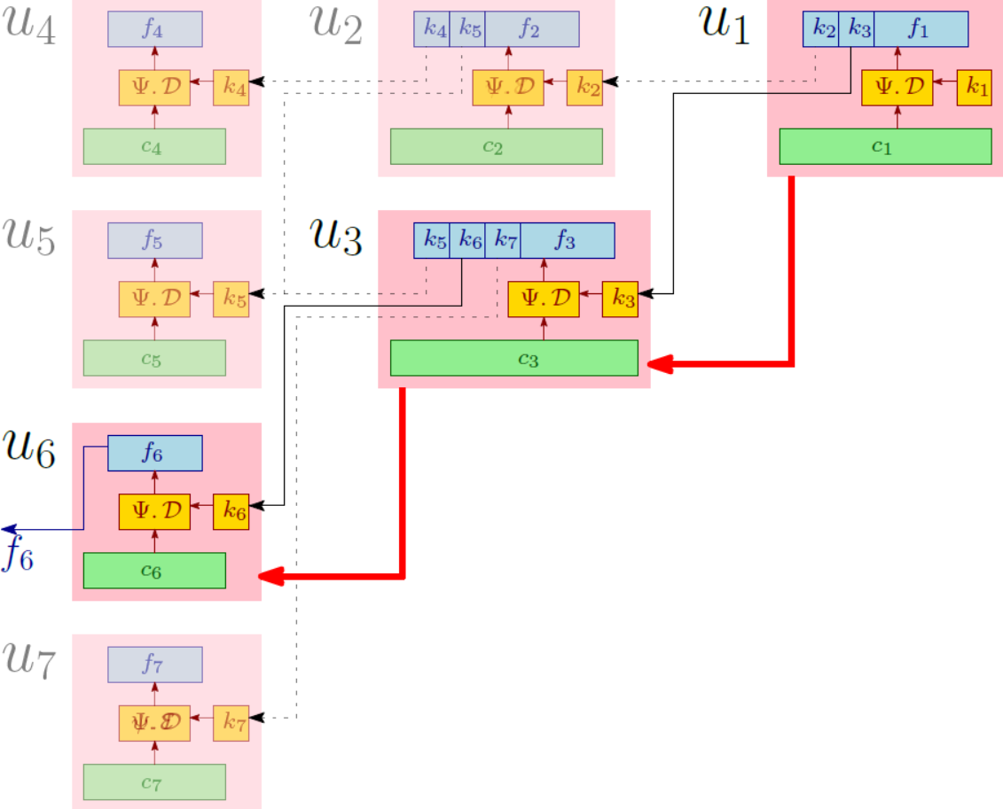
Introduction
Motivation
Problem Statement
KAS-AE Definition
KAS-AE Constructions
Comparison
Conclusion
References
Construction 1: Decryption
Reference Tree
26th March 2019
Suyash Kandele and Souradyuti Paul | Key Assignment Scheme with Authenticated Encryption | FSE 2019
(27)

Slide 30
Introduction
Motivation
Problem Statement
KAS-AE Definition
KAS-AE Constructions
Comparison
Conclusion
References
Construction 2 (1)
Based on APE Authenticated Encryption
Idea: Reverse decryption property of APE, where the keys of the immediate children nodes of the node are taken in an order and encrypted alongside the file.
Advantage:
  Allows for efficiency improvements.
  Decryption keys for the immediate children nodes are obtained on decryption.
  Do not need to store the tags for the file.
26th March 2019
Suyash Kandele and Souradyuti Paul | Key Assignment Scheme with Authenticated Encryption | FSE 2019
(28)

Slide 31
Introduction
Motivation
Problem Statement
KAS-AE Definition
KAS-AE Constructions
Comparison
Conclusion
References
Construction 2 (2)
Pictorial description of Functionality $ℱ_{1}$
Pictorial description of Functionality $ℱ_{2}$
26th March 2019
Suyash Kandele and Souradyuti Paul | Key Assignment Scheme with Authenticated Encryption | FSE 2019
(29)

Slide 32
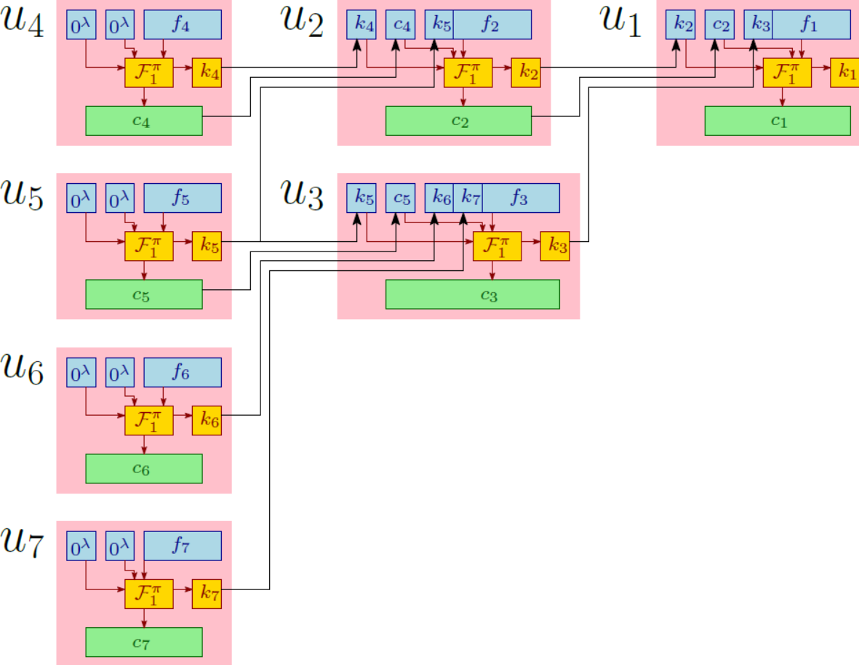
Introduction
Motivation
Problem Statement
KAS-AE Definition
KAS-AE Constructions
Comparison
Conclusion
References
Construction 2: Encryption
Reference Tree
26th March 2019
Suyash Kandele and Souradyuti Paul | Key Assignment Scheme with Authenticated Encryption | FSE 2019
(30)

Slide 33
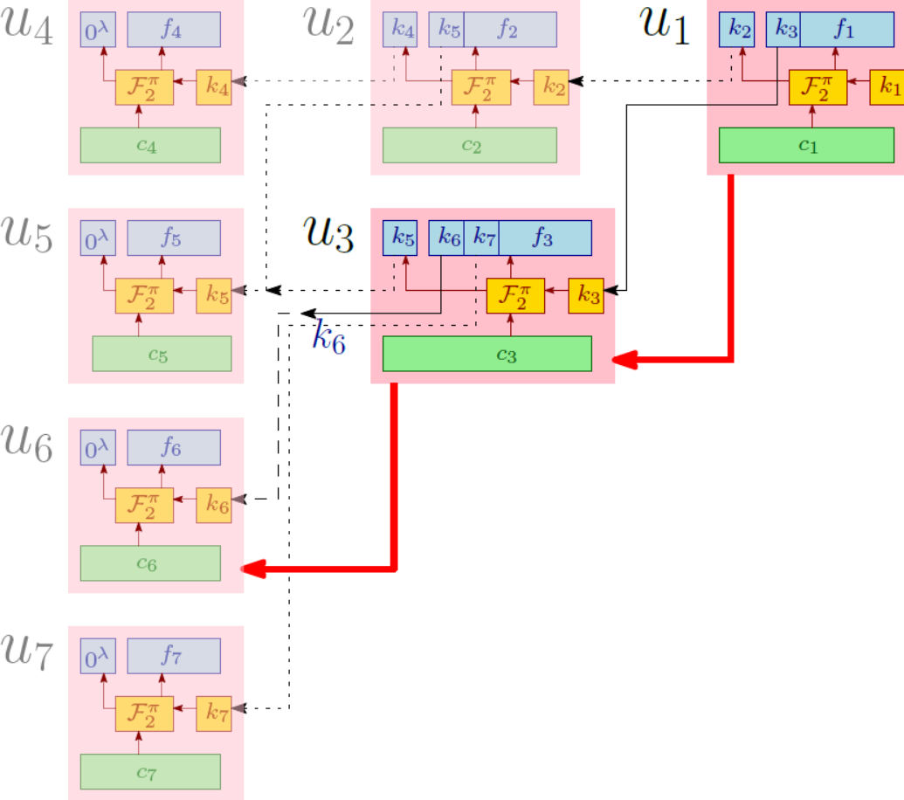
Introduction
Motivation
Problem Statement
KAS-AE Definition
KAS-AE Constructions
Comparison
Conclusion
References
Construction 2: Key Derivation
Reference Tree
26th March 2019
Suyash Kandele and Souradyuti Paul | Key Assignment Scheme with Authenticated Encryption | FSE 2019
(31)

Slide 34
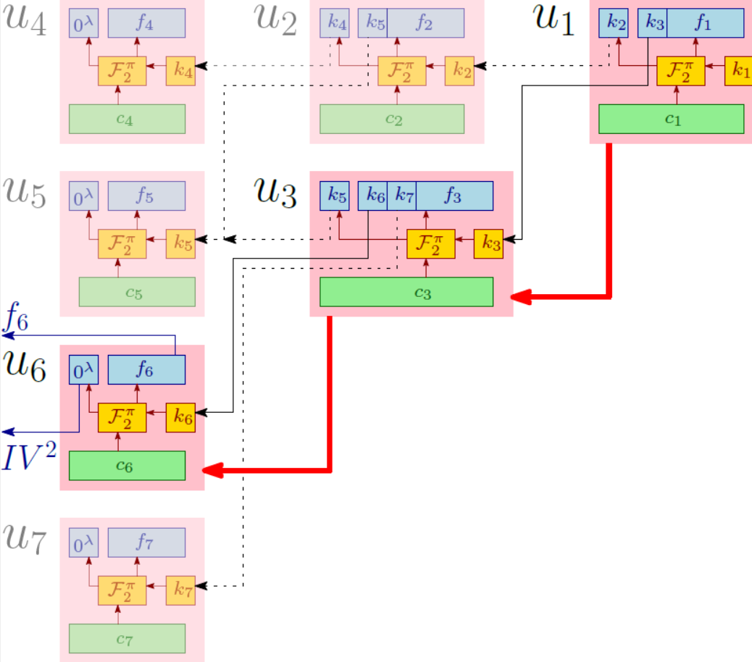
Introduction
Motivation
Problem Statement
KAS-AE Definition
KAS-AE Constructions
Comparison
Conclusion
References
Construction 2: Decryption
Reference Tree
26th March 2019
Suyash Kandele and Souradyuti Paul | Key Assignment Scheme with Authenticated Encryption | FSE 2019
(32)

Slide 35
Introduction
Motivation
Problem Statement
KAS-AE Definition
KAS-AE Constructions
Comparison
Conclusion
References
Construction 3 (1)
Based on FP Hash Mode of Operation
Idea: Reverse decryption property of a construction made by tweaking FP, where the keys of the immediate children nodes of the node are taken in an order and encrypted alongside the file.
Advantage:
  Allows for efficiency improvements.
  Decryption keys for the immediate children nodes are obtained on decryption.
  Do not need to store the tags for the file.
26th March 2019
Suyash Kandele and Souradyuti Paul | Key Assignment Scheme with Authenticated Encryption | FSE 2019
(33)

Slide 36
Introduction
Motivation
Problem Statement
KAS-AE Definition
KAS-AE Constructions
Comparison
Conclusion
References
Construction 3 (2)
Pictorial description of Functionality $𝒢_{1}$
Pictorial description of Functionality $𝒢_{2}$
26th March 2019
Suyash Kandele and Souradyuti Paul | Key Assignment Scheme with Authenticated Encryption | FSE 2019
(34)

Slide 37

Introduction
Motivation
Problem Statement
KAS-AE Definition
KAS-AE Constructions
Comparison
Conclusion
References
Construction 3: Encryption
Reference Tree
26th March 2019
Suyash Kandele and Souradyuti Paul | Key Assignment Scheme with Authenticated Encryption | FSE 2019
(35)

Slide 38
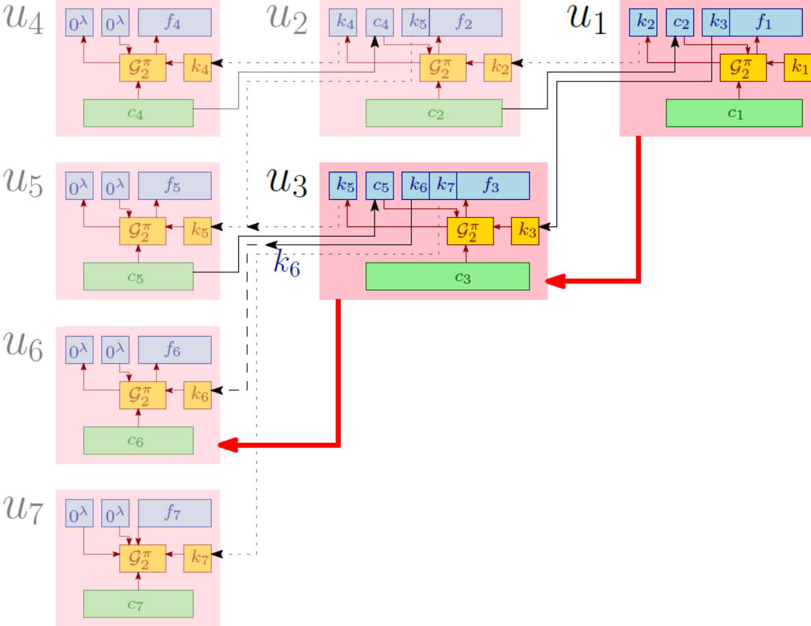
Introduction
Motivation
Problem Statement
KAS-AE Definition
KAS-AE Constructions
Comparison
Conclusion
References
Construction 3: Key Derivation
Reference Tree
26th March 2019
Suyash Kandele and Souradyuti Paul | Key Assignment Scheme with Authenticated Encryption | FSE 2019
(36)

Slide 39
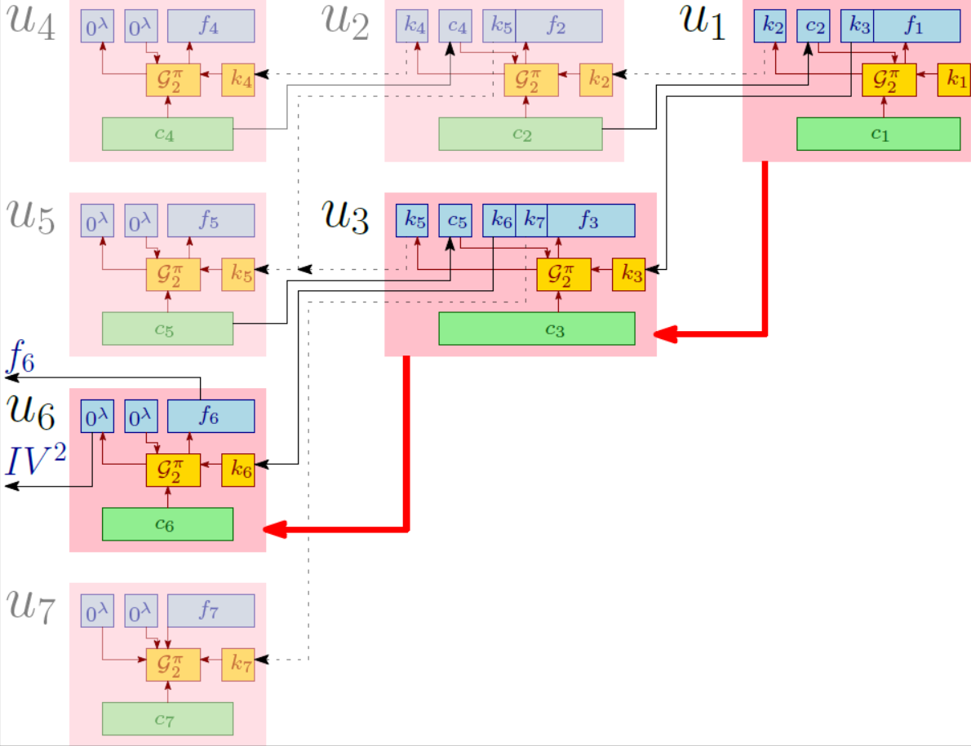
Introduction
Motivation
Problem Statement
KAS-AE Definition
KAS-AE Constructions
Comparison
Conclusion
References
Construction 3: Decryption
Reference Tree
26th March 2019
Suyash Kandele and Souradyuti Paul | Key Assignment Scheme with Authenticated Encryption | FSE 2019
(37)

Slide 40
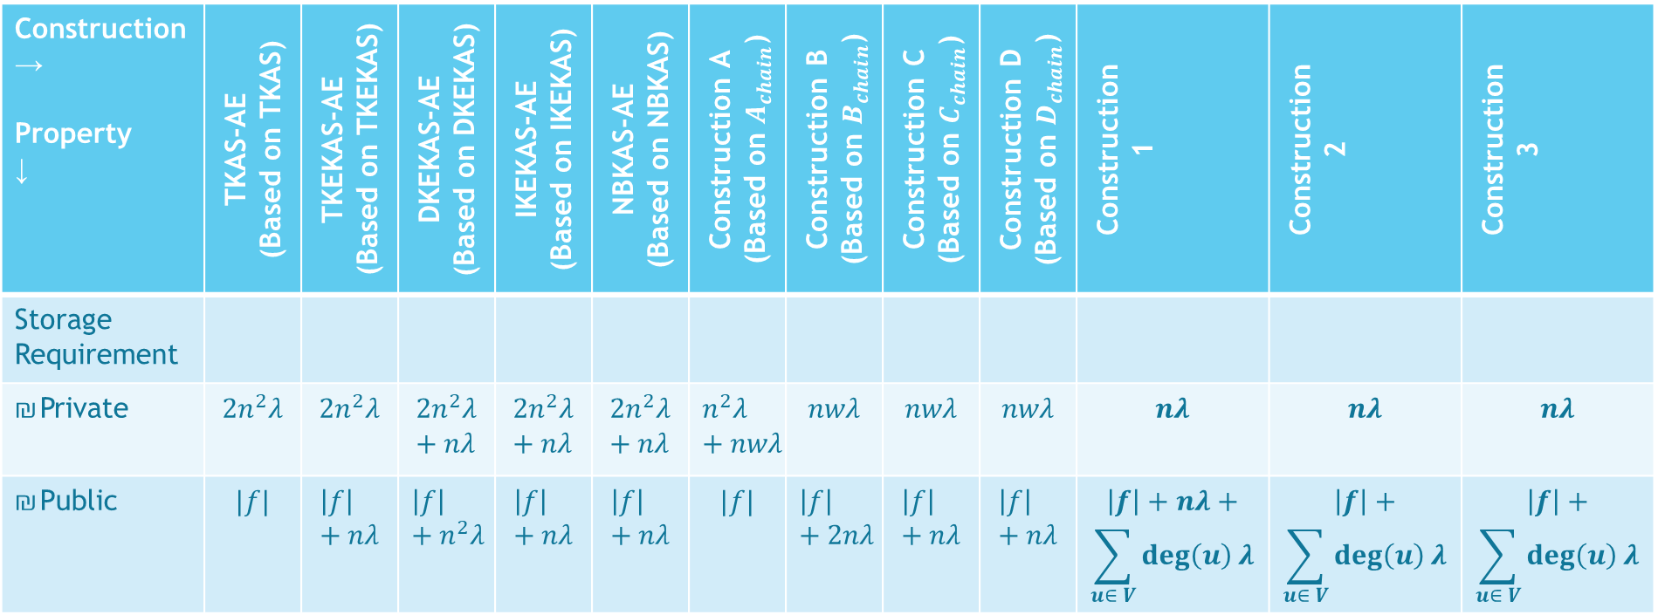
Introduction
Motivation
Problem Statement
KAS-AE Definition
KAS-AE Constructions
Comparison
Conclusion
References
Comparison Table for KAS-AE schemes
Construction → Property ↓ | TKAS-AE (Based on TKAS) | TKEKAS-AE (Based on TKEKAS) | DKEKAS-AE (Based on DKEKAS) | IKEKAS-AE (Based on IKEKAS) | NBKAS-AE (Based on NBKAS) | Construction A (Based on $A_{chain}$) | Construction B (Based on $B_{chain}$) | Construction C (Based on $C_{chain}$) | Construction D (Based on $D_{chain}$) | Construction 1 | Construction 2 | Construction 3
Storage Requirement
Private | $$2n^{2}λ$$ | $$2n^{2}λ$$ | $$2n^{2}λ+nλ$$ | $$2n^{2}λ+nλ$$ | $$2n^{2}λ+nλ$$ | $$n^{2}λ+nwλ$$ | $$nwλ$$ | $$nwλ$$ | $$nwλ$$ | $$nλ$$ | $$nλ$$ | $$nλ$$
Public | $$|f|$$ | $$\left|f\right|+nλ$$ | $$\left|f\right|+n^{2}λ$$ | $$\left|f\right|+nλ$$ | $$\left|f\right|+nλ$$ | $$|f|$$ | $$\left|f\right|+2nλ$$ | $$\left|f\right|+nλ$$ | $$\left|f\right|+nλ$$ | $$\left|f\right|+nλ+$$ $$\sum_{u∈ V}{\deg\left(u\right)}λ$$ | $$\left|f\right|+$$ $$\sum_{u∈ V}{\deg\left(u\right)}λ$$ | $$\left|f\right|+$$ $$\sum_{u∈ V}{\deg\left(u\right)}λ$$
26th March 2019
Suyash Kandele and Souradyuti Paul | Key Assignment Scheme with Authenticated Encryption | FSE 2019
(38)

Slide 41
Introduction
Motivation
Problem Statement
KAS-AE Definition
KAS-AE Constructions
Comparison
Conclusion
References
Conclusion
Construction 2 and Construction 3
  Main Ingredients:
    Reverse Decryption.
    Prepending keys of sub-ordinate nodes to the file of superior nodes.
  Based on easy-to-invert Permutation.
  Advantages:
    Easy to realise in hardware.
    Negligible Private Storage overhead.
    Randomized → No Dictionary Attack.
    One-pass Encryption, Key Derivation and Decryption.
Open Problems
  More efficient KAS-AE constructions.
  Introducing functionalities of key revocation, update, etc. in KAS-AE.
26th March 2019
Suyash Kandele and Souradyuti Paul | Key Assignment Scheme with Authenticated Encryption | FSE 2019
(39)

Slide 42
Introduction
Motivation
Problem Statement
KAS-AE Definition
KAS-AE Constructions
Comparison
Conclusion
References
References (1)
Souradyuti Paul, Ekawat Homsirikamol, and Kris Gaj. A Novel Permutation-based Hash Mode of Operation FP and the Hash Function SAMOSA. In Steven Galbraith and Mridul Nandi, editors, Progress in Cryptology - INDOCRYPT 2012, volume 7668 of Lecture Notes in Computer Science, pages 514 – 532, Kolkata,WB,INDIA, 2012. Springer-Verlag.
Elena Andreeva, Begül Bilgin, Andrey Bogdanov, Atul Luykx, Bart Mennink, Nicky Mouha, and Kan Yasuda. APE: authenticated permutation-based encryption for lightweight cryptography. In Carlos Cid and Christian Rechberger, editors, Fast Software Encryption - 21st International Workshop, FSE 2014, London, UK, March 3-5, 2014. Revised Selected Papers, volume 8540 of Lecture Notes in Computer Science, pages 168–186. Springer, 2014.
Mikhail J. Atallah, Marina Blanton, and Keith B. Frikken. Incorporating temporal capabilities in existing key management schemes. In Joachim Biskup and Javier Lopez, editors, Computer Security - ESORICS 2007, 12th European Symposium On Research In Computer Security, Dresden, Germany, September 24-26, 2007, Proceedings, volume 4734 of Lecture Notes in Computer Science, pages 515–530. Springer, 2007.
Mikhail J. Atallah, Marina Blanton, Nelly Fazio, and Keith B. Frikken. Dynamic and efficient key management for access hierarchies. ACM Trans. Inf. Syst. Secur., 12(3):18:1–18:43, 2009.
Mikhail J. Atallah, Keith B. Frikken, and Marina Blanton. Dynamic and efficient key management for access hierarchies. In Vijay Atluri, Catherine A. Meadows, and Ari Juels, editors, Proceedings of the 12th ACM Conference on Computer and Communications Security, CCS 2005, Alexandria, VA, USA, November 7-11, 2005, pages 190–202. ACM, 2005.
Giuseppe Ateniese, Alfredo De Santis, Anna Lisa Ferrara, and Barbara Masucci. Provably-secure time-bound hierarchical key assignment schemes. In Ari Juels, Rebecca N. Wright, and Sabrina De Capitani di Vimercati, editors, Proceedings of the 13th ACM Conference on Computer and Communications Security, CCS 2006, Alexandria, VA, USA, Ioctober 30 - November 3, 2006, pages 288–297. ACM, 2006.
Giuseppe Ateniese, Alfredo De Santis, Anna Lisa Ferrara, and Barbara Masucci. Provably-secure time-bound hierarchical key assignment schemes. J. Cryptology, 25(2):243–270, 2012.
Giuseppe Ateniese, Alfredo De Santis, Anna Lisa Ferrara, and Barbara Masucci. A note on time-bound hierarchical key assignment schemes. Inf. Process. Lett., 113(5-6):151–155, 2013.
Selim G. Akl and Peter D. Taylor. Cryptographic solution to a problem of access control in a hierarchy. ACM Trans. Comput. Syst., 1(3):239–248, 1983.
Elisa Bertino, Ning Shang, and Samuel S. Wagstaff Jr. An efficient time-bound hierarchical key management scheme for secure broadcasting. IEEE Trans. Dependable Sec. Comput., 5(2):65–70, 2008.
Tzer-Shyong Chen and Yu-Fang Chung. Hierarchical access control based on chinese remainder theorem and symmetric algorithm. Computers & Security, 21(6):565–570, 2002.
Hung-Yu Chien. Efficient time-bound hierarchical key assignment scheme. IEEE Trans. Knowl. Data Eng., 16(10):1301–1304, 2004.
26th March 2019
Suyash Kandele and Souradyuti Paul | Key Assignment Scheme with Authenticated Encryption | FSE 2019
(40)

Slide 43
Introduction
Motivation
Problem Statement
KAS-AE Definition
KAS-AE Constructions
Comparison
Conclusion
References
References (2)
Chin-Chen Chang, Ren-Junn Hwang, and Tzong-Chen Wu. Crypographic key assignment scheme for access control in a hierarchy. Inf. Syst., 17(3):243–247, 1992.\
Jason Crampton, Keith M. Martin, and Peter R. Wild. On key assignment for hierarchical access control. In 19th IEEE Computer Security Foundations Workshop, (CSFW-19 2006), 5-7 July 2006, Venice, Italy, pages 98–111. IEEE Computer Society, 2006.
Arcangelo Castiglione, Alfredo De Santis, and Barbara Masucci. Key in distinguishability versus strong key indistinguishability for hierarchical key assignment schemes. IEEE Trans. Dependable Sec. Comput., 13(4):451–460, 2016.
Paolo D’Arco, Alfredo De Santis, Anna Lisa Ferrara, and Barbara Masucci. Variations on a theme by akl and taylor: Security and tradeoffs. Theor. Comput. Sci., 411(1):213–227, 2010.
Eduarda S. V. Freire and Kenneth G. Paterson. Provably secure key assignment schemes from factoring. In Udaya Parampalli and Philip Hawkes, editors, Information Security and Privacy - 16th Australasian Conference, ACISP 2011, Melbourne, Australia, July 11-13, 2011. Proceedings, volume 6812 of Lecture Notes in Computer Science, pages 292–309. Springer, 2011.
Eduarda S. V. Freire, Kenneth G. Paterson, and Bertram Poettering. Simple, efficient and strongly ki-secure hierarchical key assignment schemes. In Ed Dawson, editor, Topics in Cryptology - CT-RSA 2013 - The Cryptographers’ Track at the RSA Conference 2013, San Francisco,CA, USA, February 25-March 1, 2013. Proceedings, volume 7779 of Lecture Notes in Computer Science, pages 101–114. Springer, 2013.
Ehud Gudes. The design of a cryptopgraphy based secure file system. IEEE Trans. Software Eng., 6(5):411–420, 1980.
Hui-Feng Huang and Chin-Chen Chang. A new cryptographic key assignment scheme with time-constraint access control in a hierarchy. Computer Standards & Interfaces, 26(3):159–166, 2004.
Lein Harn and Hung-Yu Lin. A cryptographic key generation scheme for multilevel data security. Computers & Security, 9(6):539–546, 1990.
Stephen J. MacKinnon, Peter D. Taylor, Henk Meijer, and Selim G. Akl. An optimal algorithm for assigning cryptographic keys to control access in a hierarchy. IEEE Trans. Computers, 34(9):797–802, 1985.
Victor R. L. Shen and Tzer-Shyong Chen. A novel key management scheme based on discrete logarithms and polynomial interpolations. Computers & Security, 21(2):164–171, 2002.
Alfredo De Santis, Anna Lisa Ferrara, and Barbara Masucci. Efficient provably secure hierarchical key assignment schemes. In Ludek Kucera and Antonín Kucera, editors, Mathematical Foundations of Computer Science 2007, 32nd International Symposium, MFCS 2007, Ceský Krumlov, Czech Republic, August 26-31, 2007, Proceedings, volume 4708 of Lecture Notes in Computer Science, pages 371–382. Springer, 2007.
Alfredo De Santis, Anna Lisa Ferrara, and Barbara Masucci. New constructions for provably-secure time-bound hierarchical key assignment schemes. In Volkmar Lotz and Bhavani M. Thuraisingham, editors, 12th ACM Symposium on Access Control Models and Technologies, SACMAT 2007, Sophia Antipolis, France, June 20-22, 2007, Proceedings, pages 133–138. ACM, 2007.
26th March 2019
Suyash Kandele and Souradyuti Paul | Key Assignment Scheme with Authenticated Encryption | FSE 2019
(41)

Slide 44
Introduction
Motivation
Problem Statement
KAS-AE Definition
KAS-AE Constructions
Comparison
Conclusion
References
References (3)
Alfredo De Santis, Anna Lisa Ferrara, and Barbara Masucci. New constructions for provably-secure time-bound hierarchical key assignment schemes. Theor. Comput. Sci., 407(1-3):213–230, 2008.
Hui-Min Tsai and Chin-Chen Chang. A cryptographic implementation for dynamic access control in a user hierarchy. Computers & Security, 14(2):159–166, 1995.
Wen-Guey Tzeng. A time-bound cryptographic key assignment scheme for access control in a hierarchy. IEEE Trans. Knowl. Data Eng., 14(1):182–188, 2002.
Wen-Guey Tzeng. A secure system for data access based on anonymous authentication and time-dependent hierarchical keys. In Ferng-Ching Lin, Der-Tsai Lee, Bao-Shuh Paul Lin, Shiuhpyng Shieh, and Sushil Jajodia, editors, Proceedings of the 2006 ACM Symposium on Information, Computer and Communications Security, ASIACCS 2006, Taipei, Taiwan, March 21-24, 2006, pages 223–230. ACM, 2006.
Tzong-Chen Wu and Chin-Chen Chang. Cryptographic key assignment scheme for hierarchical access control. Comput. Syst. Sci. Eng., 16(1):25–28, 2001.
Shyh-Yih Wang and Chi-Sung Laih. Merging: An efficient solution for a time-bound hierarchical key assignment scheme. IEEE Trans. Dependable Sec. Comput., 3(1):91–100, 2006.
Jyh-haw Yeh, Randy Chow, and Richard E. Newman. Key assignment for enforcing access control policy exceptions in distributed systems. Inf. Sci., 152:63–88, 2003.
Jyh-haw Yeh. An rsa-based time-bound hierarchical key assignment scheme for electronic article subscription. In Otthein Herzog, Hans-Jörg Schek, Norbert Fuhr, Abdur Chowdhury, and Wilfried Teiken, editors, Proceedings of the 2005 ACM CIKM International Conference on Information and Knowledge Management, Bremen, Germany, October 31 - November 5, 2005, pages 285–286. ACM, 2005.
Xun Yi. Security of chien’s efficient time-bound hierarchical key assignment scheme. IEEE Trans. Knowl. Data Eng., 17(9):1298–1299, 2005.
Cungang Yang and Celia Li. Access control in a hierarchy using one-way hash functions. Computers & Security, 23(8):659–664, 2004.
Xun Yi and Yiming Ye. Security of tzeng’s time-bound key assignment scheme for access control in a hierarchy. IEEE Trans. Knowl. Data Eng., 15(4):1054–1055, 2003.
Xukai Zou, Byrav Ramamurthy, and Spyros S. Magliveras. Chinese remainder theorem based hierarchical access control for secure group communication. In Sihan Qing, Tatsuaki Okamoto, and Jianying Zhou, editors, Information and Communications Security, Third International Conference, ICICS 2001, Xian, China, November 13-16, 2001, volume 2229 of Lecture Notes in Computer Science, pages 381–385. Springer, 2001.
Jason Crampton, Rosli Daud, and Keith M. Martin. Constructing key assignment schemes from chain partitions. In Sara Foresti and Sushil Jajodia, editors, Data and Applications Security and Privacy XXIV, 24th Annual IFIP WG 11.3 Working Conference, Rome, Italy, June 21-23, 2010. Proceedings, volume 6166 of Lecture Notes in Computer Science, pages 130–145. Springer, 2010.
Tzer-Shyong Chen and Jen-Yan Huang. A novel key management scheme for dynamic access control in a user hierarchy. Applied Mathematics and Computation, 162(1):339–351, 2005.
26th March 2019
Suyash Kandele and Souradyuti Paul | Key Assignment Scheme with Authenticated Encryption | FSE 2019
(42)

Slide 45
THANK YOU

Slide 46
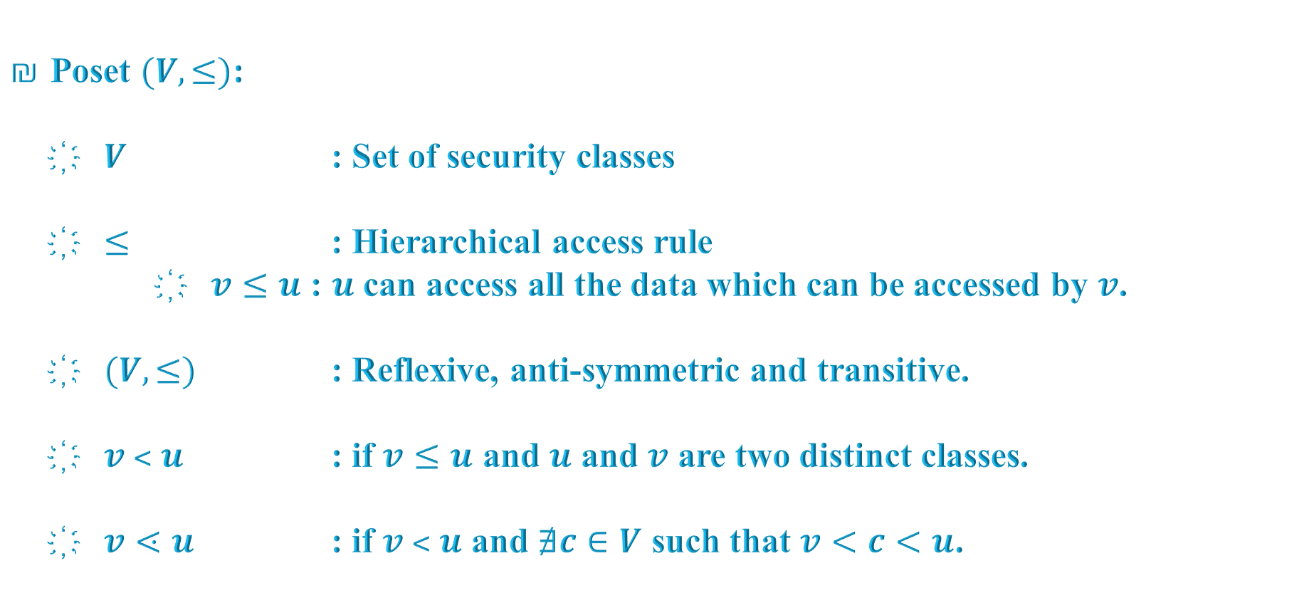
Introduction
Problem Statement
Our Work
Comparison
References
26th March 2019
(A)
KAS: Representation (2)
Poset $(V,≤)$:
  $V$ : Set of security classes
  $≤$ : Hierarchical access rule
      $v≤u$ : $u$ can access all the data which can be accessed by $v$.
  $(V,≤)$ : Reflexive, anti-symmetric and transitive.
  $v ˂ u$ : if $v≤u$ and $u$ and $v$ are two distinct classes.
  $v⋖u$ : if $v ˂ u$ and $∄c∈V$ such that $v<c<u$.
Suyash Kandele and Souradyuti Paul | Key Assignment Scheme with Authenticated Encryption | FSE 2019

Slide 47

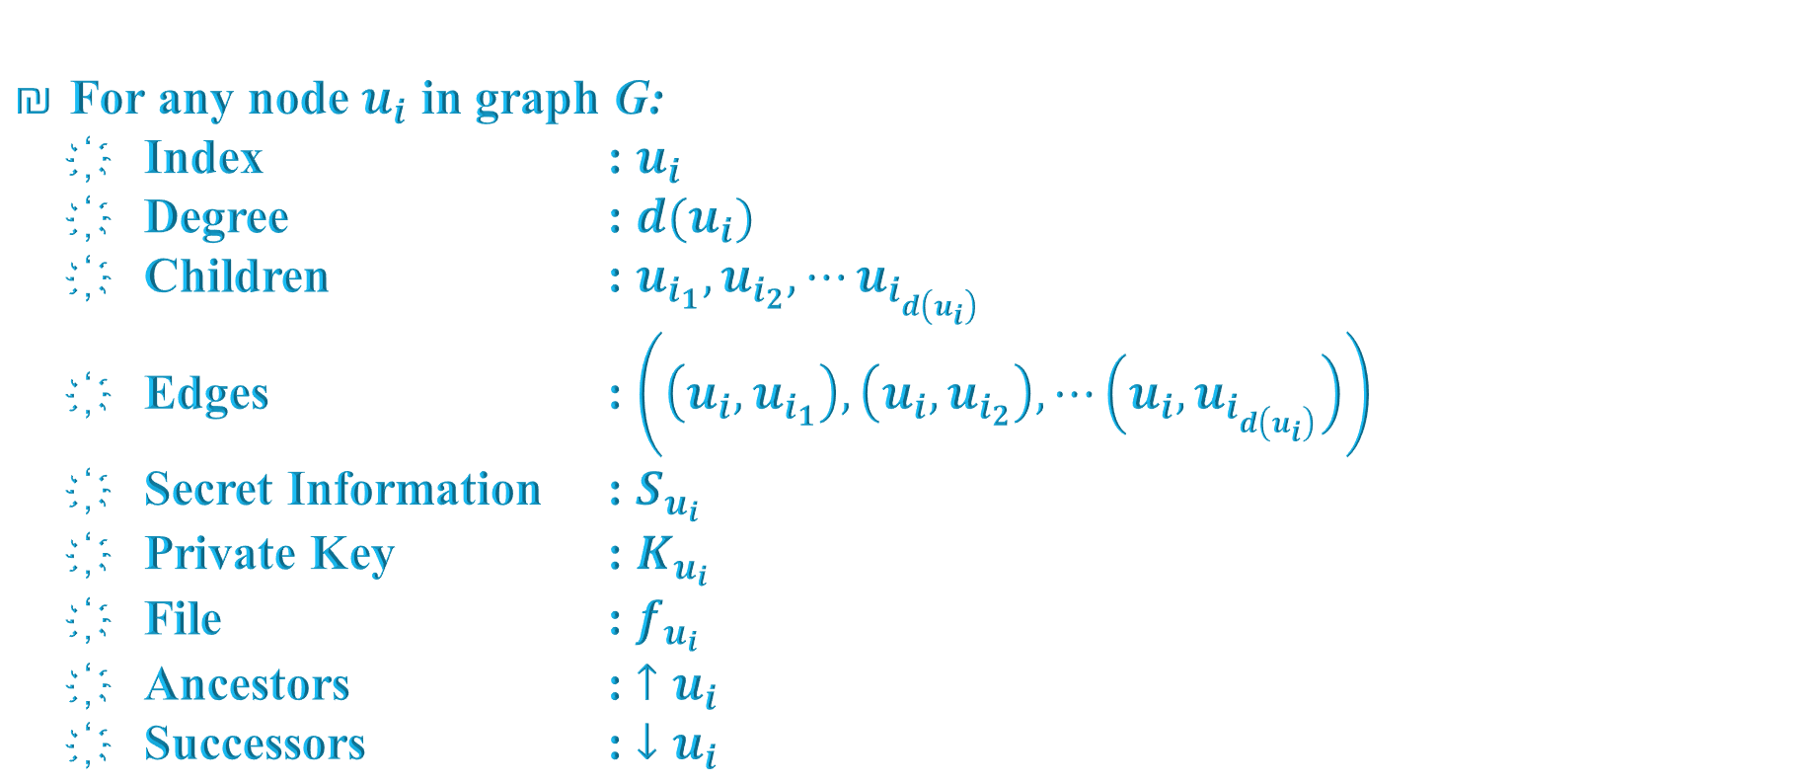



Introduction
Problem Statement
Our Work
Comparison
References
26th March 2019
(B)
KAS: Representation (3)
For any node $u_{i}$ in graph G:
  Index : $u_{i}$
  Degree : $d(u_{i})$
  Children : $u_{i_{1}},u_{i_{2}},⋯u_{i_{d\left(u_{i}\right)}}$
  Edges : $\left(\left(u_{i},u_{i_{1}}\right),\left(u_{i},u_{i_{2}}\right),⋯\left(u_{i},u_{i_{d\left(u_{i}\right)}}\right)\right)$
  Secret Information : $S_{u_{i}}$
  Private Key : $K_{u_{i}}$
  File : $f_{u_{i}}$
  Ancestors : $↑u_{i}$
  Successors : $↓u_{i}$
$$u_{i}$$
$$u_{i_{1}}$$
$$u_{i_{2}}$$
. . .
$$u_{i_{d(u_{i})}}$$
Suyash Kandele and Souradyuti Paul | Key Assignment Scheme with Authenticated Encryption | FSE 2019

Slide 48
Introduction
Problem Statement
Our Work
Comparison
References
26th March 2019
(C)
KAS: State-of-the-art – Overview
Freire and Paterson (FP)
- By Eduarda S.V. Freire and Kenneth G. Paterson, 2011.
Functionalities:
  Key Generation
  Key Derivation
Ingredients:
  Factoring Problem
  Chain Partition Algorithm
Suyash Kandele and Souradyuti Paul | Key Assignment Scheme with Authenticated Encryption | FSE 2019

Slide 49
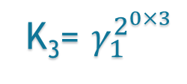
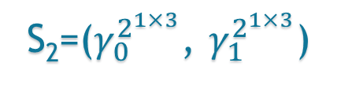

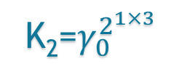
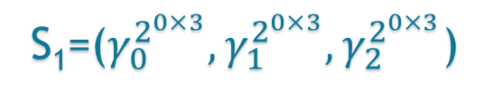
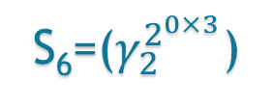
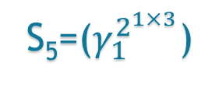
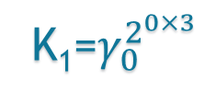
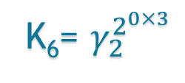






Introduction
Problem Statement
Our Work
Comparison
References
26th March 2019
(D)
FP: Key Generation
u₁
K₁=$γ_{0}^{2^{0×3}}$
S₁=($γ_{0}^{2^{0×3}},γ_{1}^{2^{0×3}},γ_{2}^{2^{0×3}}$)
u₂
K₂=$γ_{0}^{2^{1×3}}$
u₃
K₃= $γ_{1}^{2^{0×3}}$
S₂=($γ_{0}^{2^{1×3}}$, $γ_{1}^{2^{1×3}}$)
S₃=($γ_{1}^{2^{0×3}},γ_{2}^{2^{0×3}}$)
v₄
K₄= $γ_{0}^{2^{2×3}}$
u₅
K₅= $γ_{1}^{2^{1×3}}$
u₆
K₆= $γ_{2}^{2^{0×3}}$
S₄=($γ_{0}^{2^{2×3}}$)
S₅=($γ_{1}^{2^{1×3}}$)
S₆=($γ_{2}^{2^{0×3}}$)
C₀,$γ_{0}$
C₁,$γ_{1}$
C₂,$γ_{2}$
Suyash Kandele and Souradyuti Paul | Key Assignment Scheme with Authenticated Encryption | FSE 2019

Slide 50





Introduction
Problem Statement
Our Work
Comparison
References
26th March 2019
(E)
FP: Key Derivation
u₁
K₁=$γ_{0}^{2^{0×3}}$
S₁=($γ_{0}^{2^{0×3}},γ_{1}^{2^{0×3}},γ_{2}^{2^{0×3}}$)
$$γ_{1}^{2^{0×3}}$$
u₂
u₃
$${\left(γ_{1}^{2^{0×3}}\right)}^{2^{\left(1−0\right)×3}}$$
$$=γ_{1}^{2^{0×3}×2^{\left(1−0\right)×3}}$$
$${=γ}_{1}^{2^{0×3+\left(1−0\right)×3}}$$
$${=γ}_{1}^{2^{(0+\left(1−0\right))×3}}$$
$${=γ}_{1}^{2^{1×3}}$$
v₄
u₅
K₅= $γ_{1}^{2^{1×3}}$
u₆
C₀
C₁
C₂
Suyash Kandele and Souradyuti Paul | Key Assignment Scheme with Authenticated Encryption | FSE 2019

Slide 51

Comparison Table for KAS-AE schemes (1)

Slide 52

Comparison Table for KAS-AE schemes (2)

Slide 53

Comparison Table for KAS-AE schemes (3)

